Slide 1

The Unequal Burden of a Changing Climate: Extreme Weather Shocks and Infant Mortality
July 2025

Slide 2
Data employed
DHS | Climate Data
 | ( ERA5)
60 countries | Worldwide coverage
Years 1998 to 2021 | Years 1991 to 2021
Annual | Monthly
Geo-located data is displaced up to 5 km (0-2 km urban, 0-5 km rural) | 0.5 x 0.5 gridded satellite data (~50km in equator, ~65km next to poles)
Mortality data for the first four quarters of life and three quarters of gestation of the mother | Temperature and Precipitation data

Slide 3
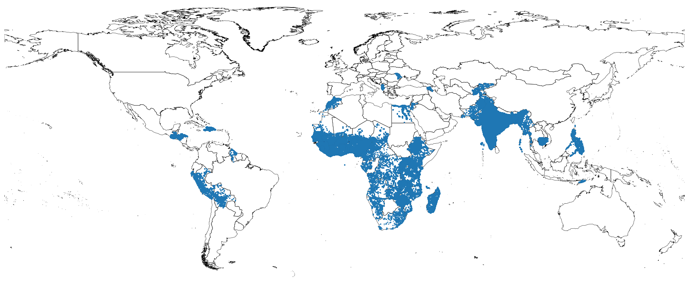
DHS Data

Slide 4
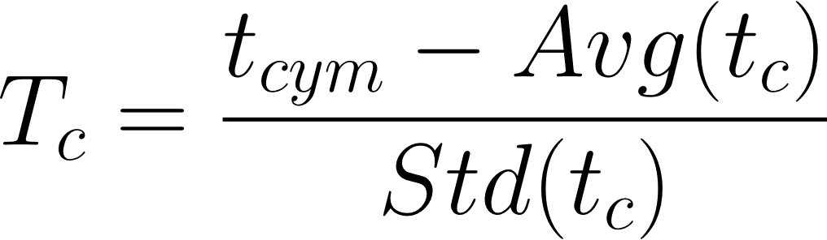
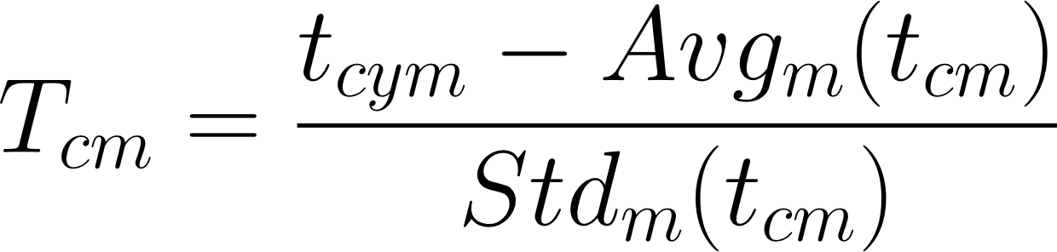
Climate Data: How should we measure Temperature shocks?
This is a discussion that we have been going for long, but now in the light of the new results its more relevant than previously was.
Using the linear dummy model with SPI, we've found consistent results for standardized temperature and monthly temperature anomalies:
Given the fact that we include monthly fixed effects in the regressions, it's likely that both estimates are similar (which in fact they are).
Standardized temperature
Monthly temperature anomalies

Slide 5
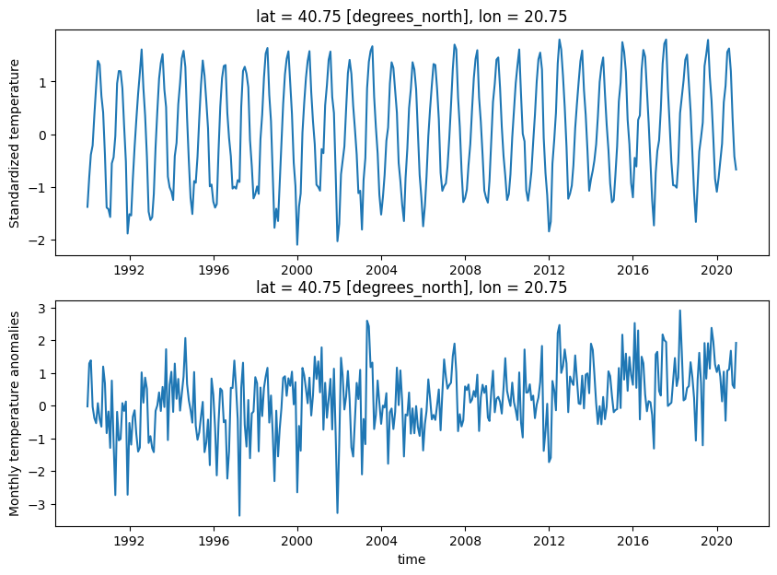
Climate Data: How should we measure Temperature shocks?
This is a discussion that we have been going for long, but now in the light of the new results its more relevant than previously was.
Using the linear dummy model with SPI, we've found consistent results for standardized temperature and monthly temperature anomalies...

Slide 6
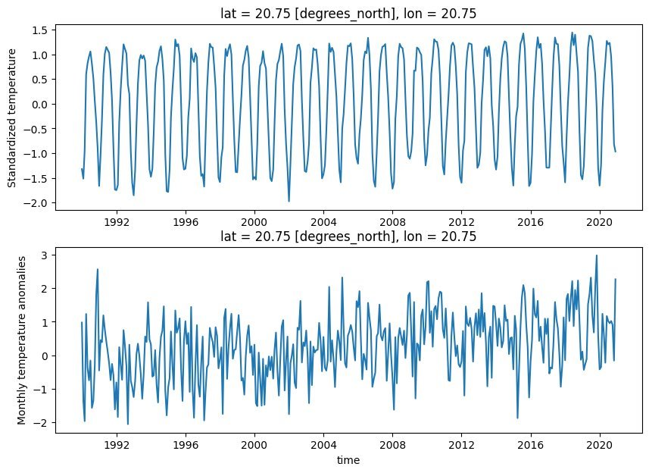
Climate Data: How should we measure Temperature shocks?
This is a discussion that we have been going for long, but now in the light of the new results its more relevant than previously was.
Using the linear dummy model with SPI, we've found consistent results for standardized temperature and monthly temperature anomalies...

Slide 7
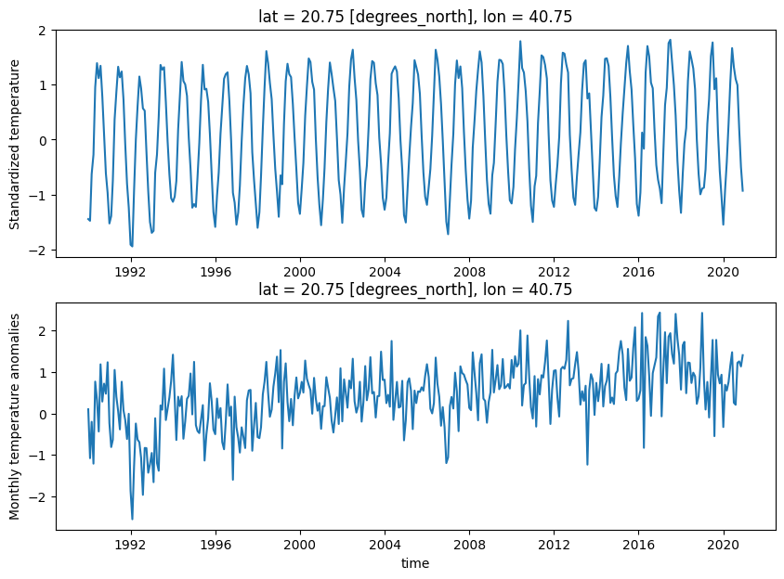
Climate Data: How should we measure Temperature shocks?
This is a discussion that we have been going for long, but now in the light of the new results its more relevant than previously was.
Using the linear dummy model with SPI, we've found consistent results for standardized temperature and monthly temperature anomalies...

Slide 8
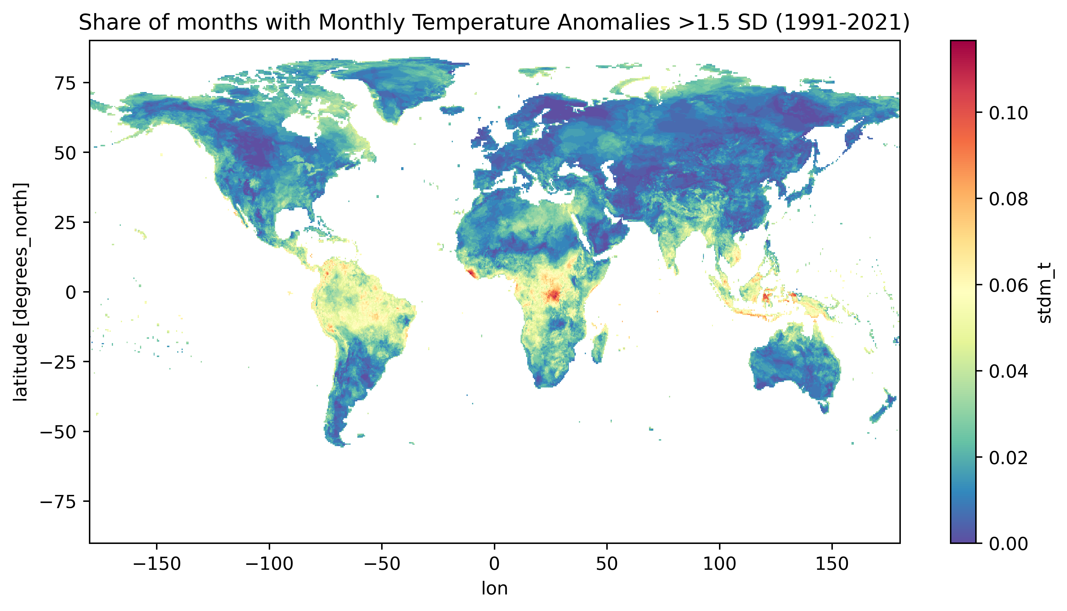
Climate Data: How should we measure Temperature shocks?
How likely are these monthly temperature anomalies?
Near the equator, there is a 3-month high temperature shock every 1.6 years

Slide 9
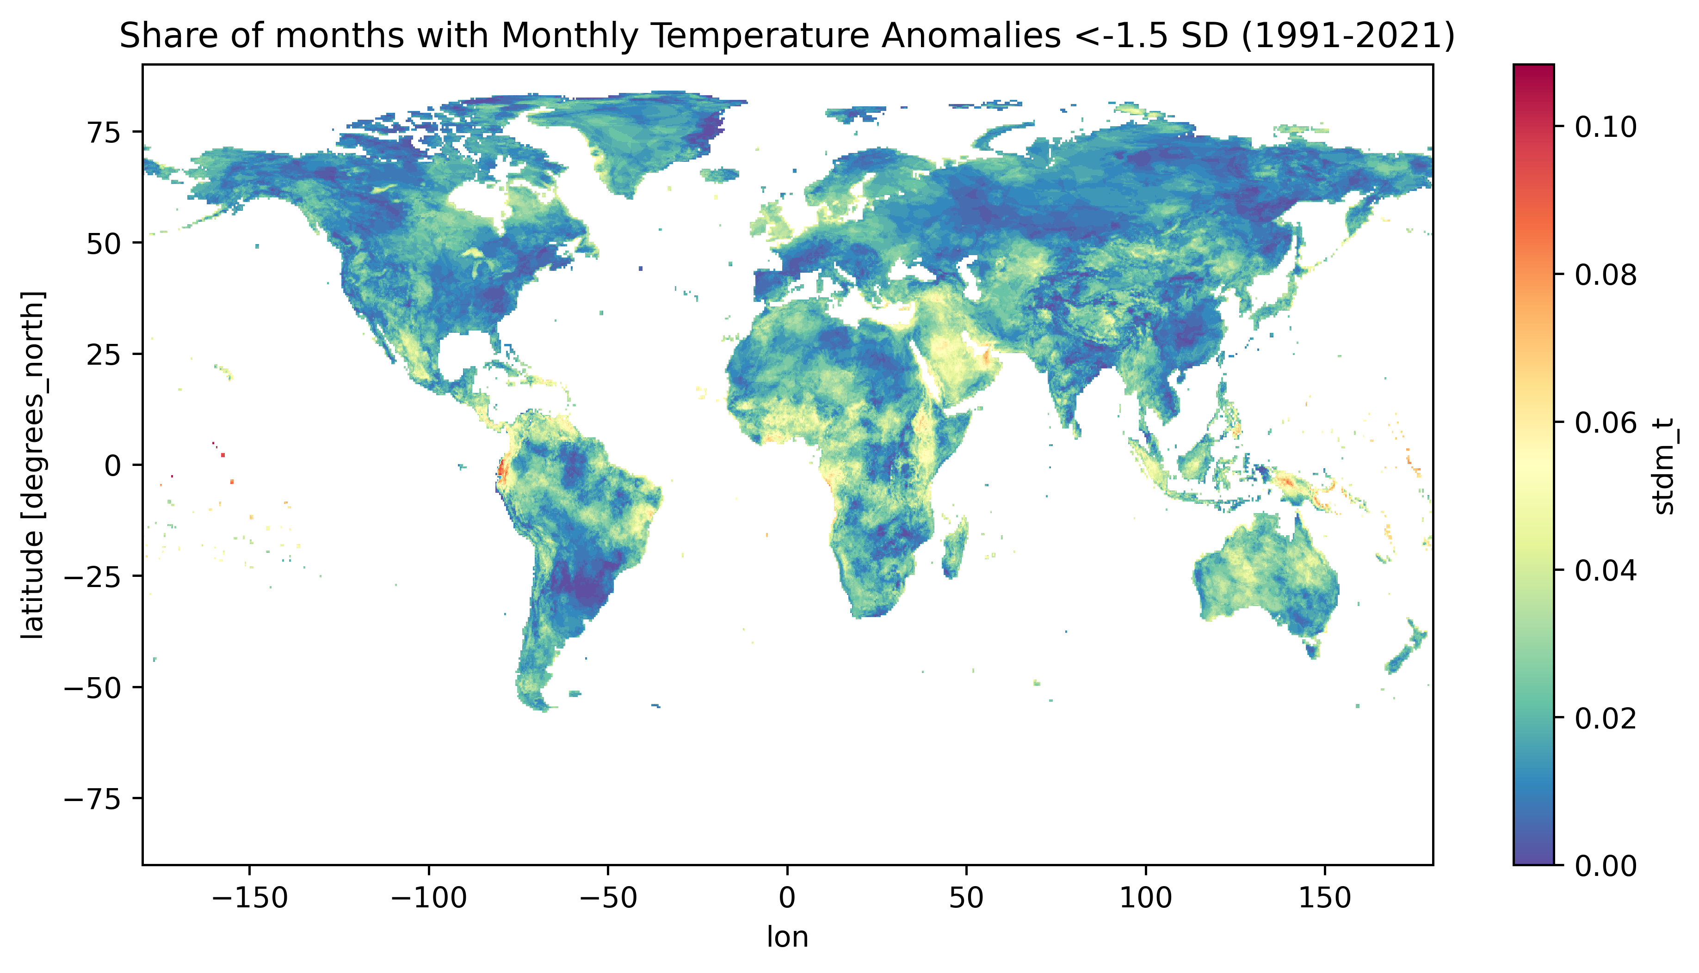

Climate Data: How should we measure Temperature shocks?
How likely are these monthly temperature anomalies?
A 3-month low temperature shock is quite common too, with many parts of the world painted in yellow (meaning a 3-month shock every 1.6 years)

Slide 10
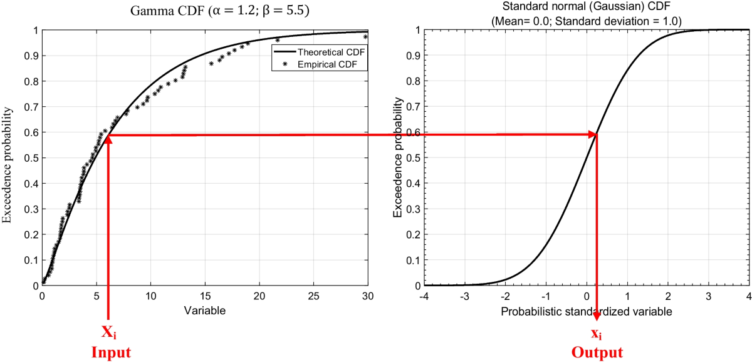
Climate Data: How should we measure Precipitation shocks?
Precipitation data is highly skewed, so a simple standardization might not be a good solution.
The Standardized precipitation Index comes in handy as it is an indicator easy to compute, comparable between countries, and with a similar interpretation than standardized temperature anomalies.​
It is computed by fitting the observed distribution of each cell to a Gamma distribution, and then matching it to a normal distribution.

Slide 11
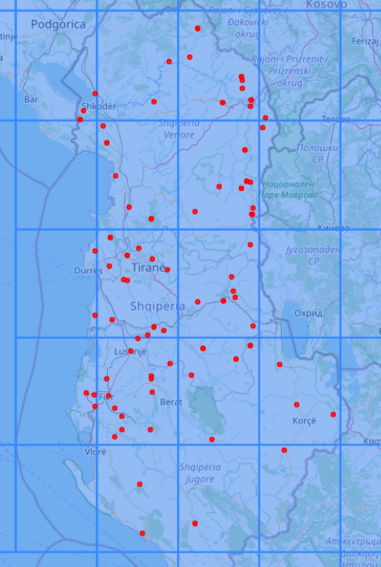
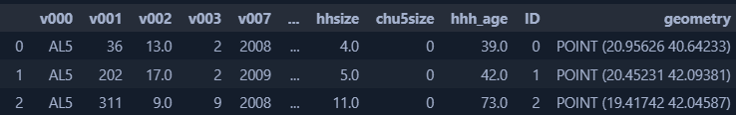
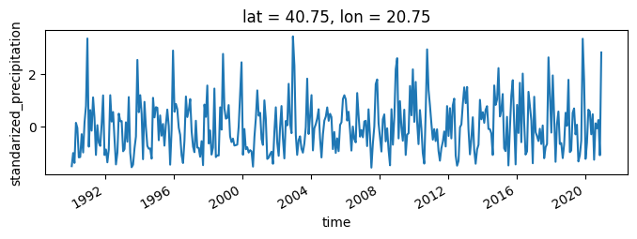
Merging Climate data with DHS data
We first assign each DHS observation to a single cell of the grid with the climate data
DHS data
Climate data

Slide 12
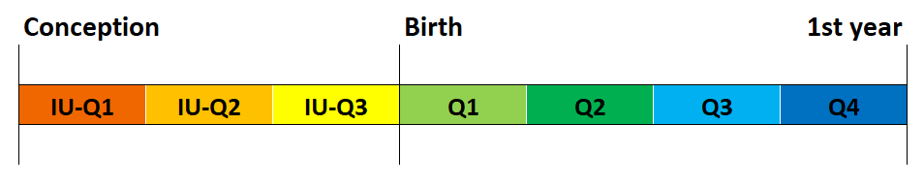
Creating exposure variables
Weather exposure is divided into 7 quarters: 3 in utero quarters, 4 quarters after birth
We compute the average 1-month Standardized Precipitation Index and Standardized Temperature Anomaly for the corresponding quarter.

Slide 13
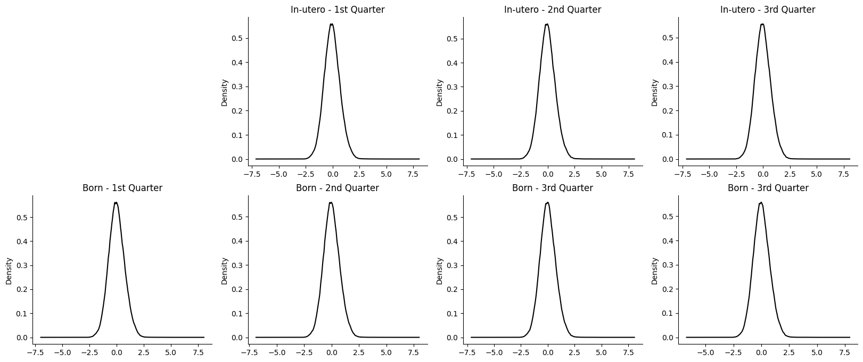
Resulting shock distribution

Slide 14
Empirical Identification Strategy

Slide 15
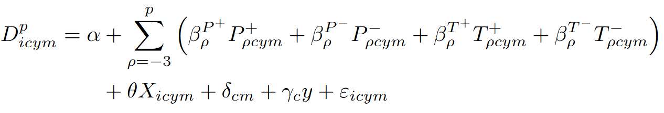
Empirical Strategy: linear model
Estimated for each period p conditional on survival to p-1, where:
D is a dummy variable equal to 1 if the child i, living in cell c, born in year y, and in month m, died. This dummy is multiplied by 1,000 to reflect mortality rates per 1,000 children instead of probability in the estimates.
P and T are the precipitation (SPI) and temperature indicates of the cell at the period rho (each quarter in utero and until the first age).
X is a set of controls including child gender, multiple birth indicator, birth order, age of mother (cubic), years of maternal education (cubic), rural indicator and the meta relative wealth index of the cell.
Delta represents fixed effects for cell-month (for stationarity) and gamma represents cell fixed effects interacted with time to control for a cell-specific linear trends.

Slide 16
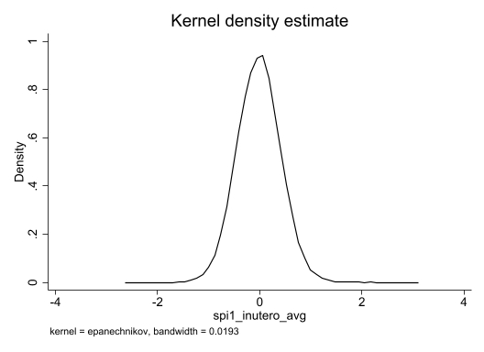
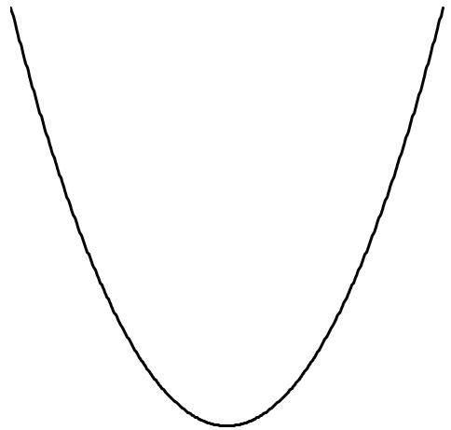
Empirical Strategy: linear model
What we expect is that extreme shocks (in any direction) will lead to an increase in child mortality: the further the indicator is from zero, the higher the increase in mortality.
Child Mortality

Slide 17
Empirical Strategy: linear model
What we expect is that extreme shocks (in any direction) will lead to an increase in child mortality: the further the indicator is from zero, the higher the increase in mortality.
A negative coefficient means
↑ Deaths
A positive coefficient means
↑ Deaths
Child Mortality

Slide 18
Cell identifiers for the spatial fixed effect
Number of observations in each cluster of cell#month, with different cell sizes
We constructed IDs for each cell.
Since some cells had only a few households, we tested if combining these cells and creating larger groups mantained the results.
 | Ungrouped | Groups of 4 cells | Groups of 16 cells | Groups of 64 cells
Grid size (side) | 0.5° | 1° | 2° | 4°
Size in km | 50x50km | 100x100km | 200x200km | 400x400km
Number of children
Less than 5 | 15.3% | 9.1% | 5.1% | 2.6%
Less than 10 | 30.5% | 18.1% | 9.9% | 6.6%
Less than 20 | 47.6% | 30.0% | 16.4% | 10.7%
Less than 30 | 57.8% | 37.8% | 20.5% | 13.4%
Less than 40 | 65.0% | 43.5% | 24.0% | 15.7%
Less than 50 | 70.5% | 48.2% | 27.1% | 17.1%
Less than 100 | 84.8% | 62.7% | 39.8% | 23.8%

Slide 19
Are our wealth controls ok?
We are controling with the DHS wealth quintiles (PCA estimates based on assets).
This means we were comparing the "wealthiest" 20% in a country like Madagascar directly with the "wealthiest" 20% in Peru, even though their absolute wealth is vastly different.
This led to counter-intuitive results in our initial heterogeneity analysis (e.g., unexpected vulnerability of no-access to fridge to low temperature shocks).
What is more important for our regressions? Country-level relative wealth or absolute wealth?
We have re-run the models but using a more absolute measure of wealth: the Relative Wealth Index developed by Meta

Slide 20
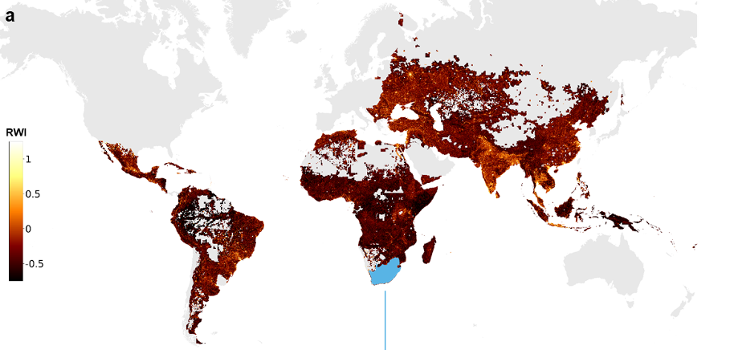
Are our wealth controls ok? Meta RWI
But, with this approach, the Income Group heterogeneity disappears…

Slide 21
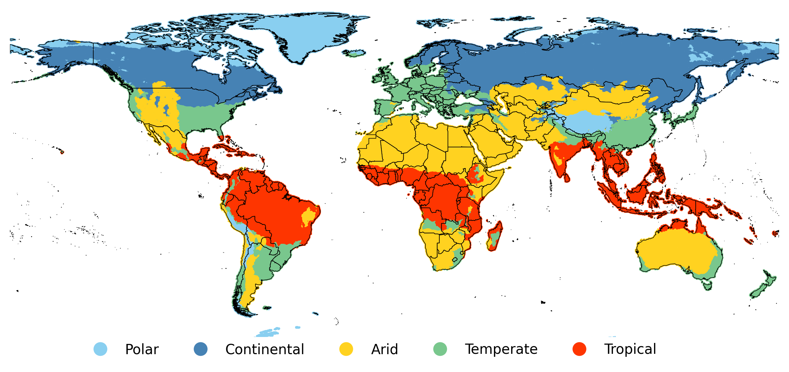
Heterogeneity: Climatic bands
To define climatic bands (i.e. groups based on patterns of seasonal precipitation and temperature) we used the Köppen-Geiger climate classification published by Kottek et al. (2006), Rubel and Kottek (2010) and Rubel et al. (2017).

Slide 22
Results

Slide 23
Main coefficients:
Quarterly grouped
Month by month
Averaging window?
N° of days Tmax>35/40
“Horserace”

Slide 24
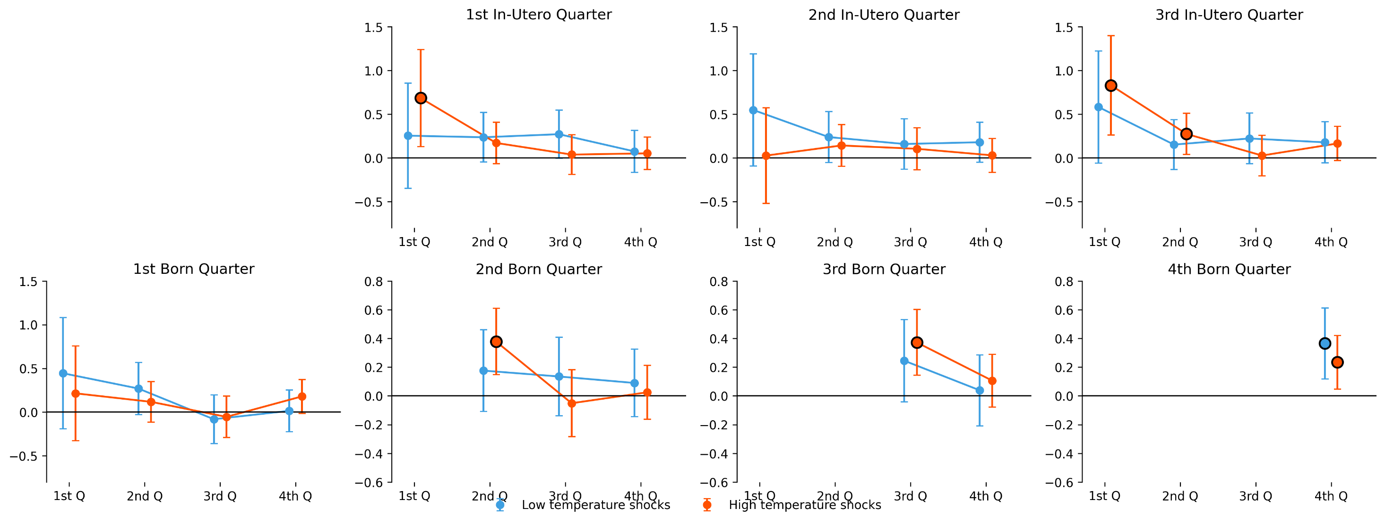
1) Main Results - Temperature
In útero behaviour is consistent with the most vulternable periods: greater chances of miscarriage are in the first quarter of pregnancy, and greater chances of stillbirth at the end of gestation.
But is weird we do not find anything on the 1st quarter. Later i’ll discuss this.

Slide 25
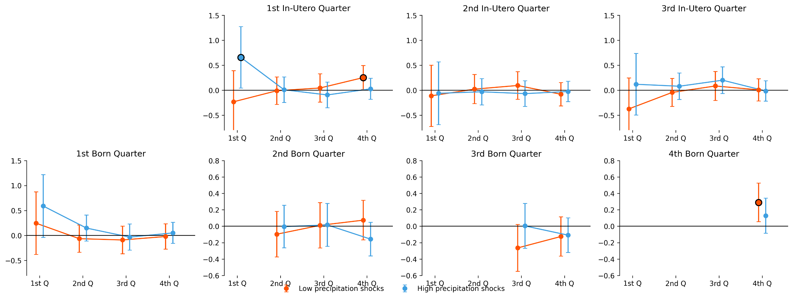
1) Main Results - Precipitation

Slide 26
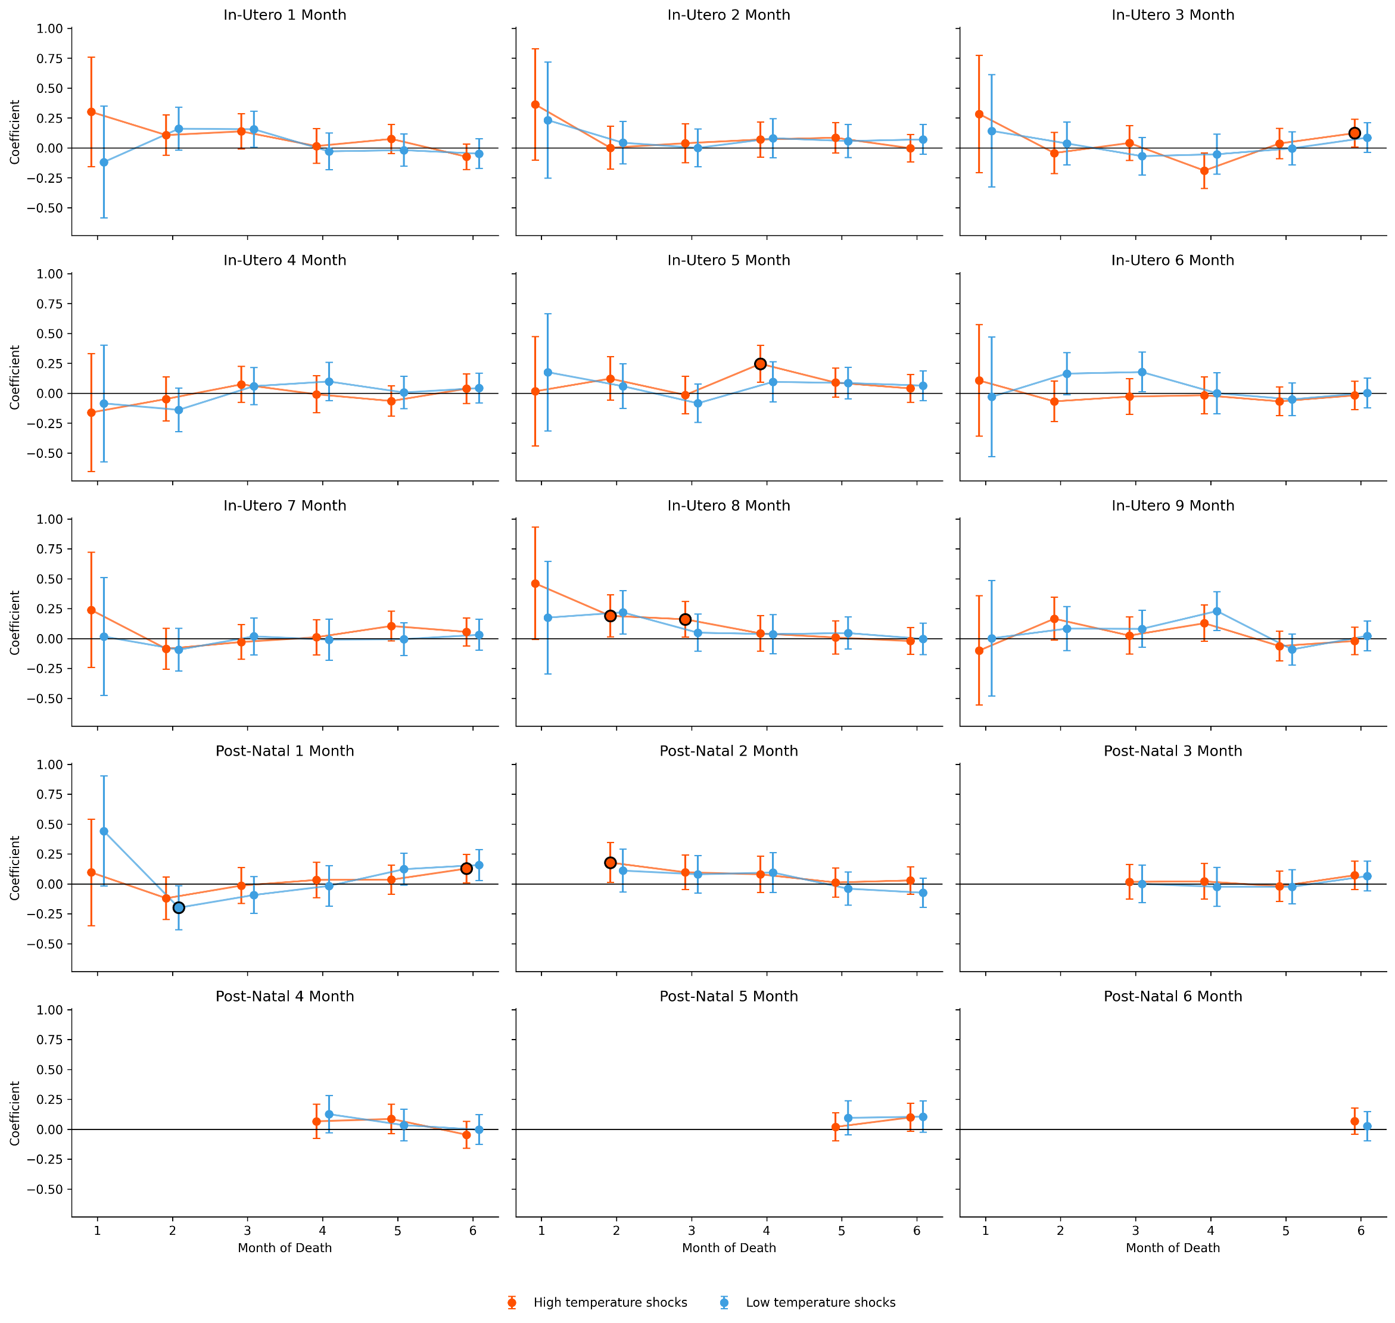
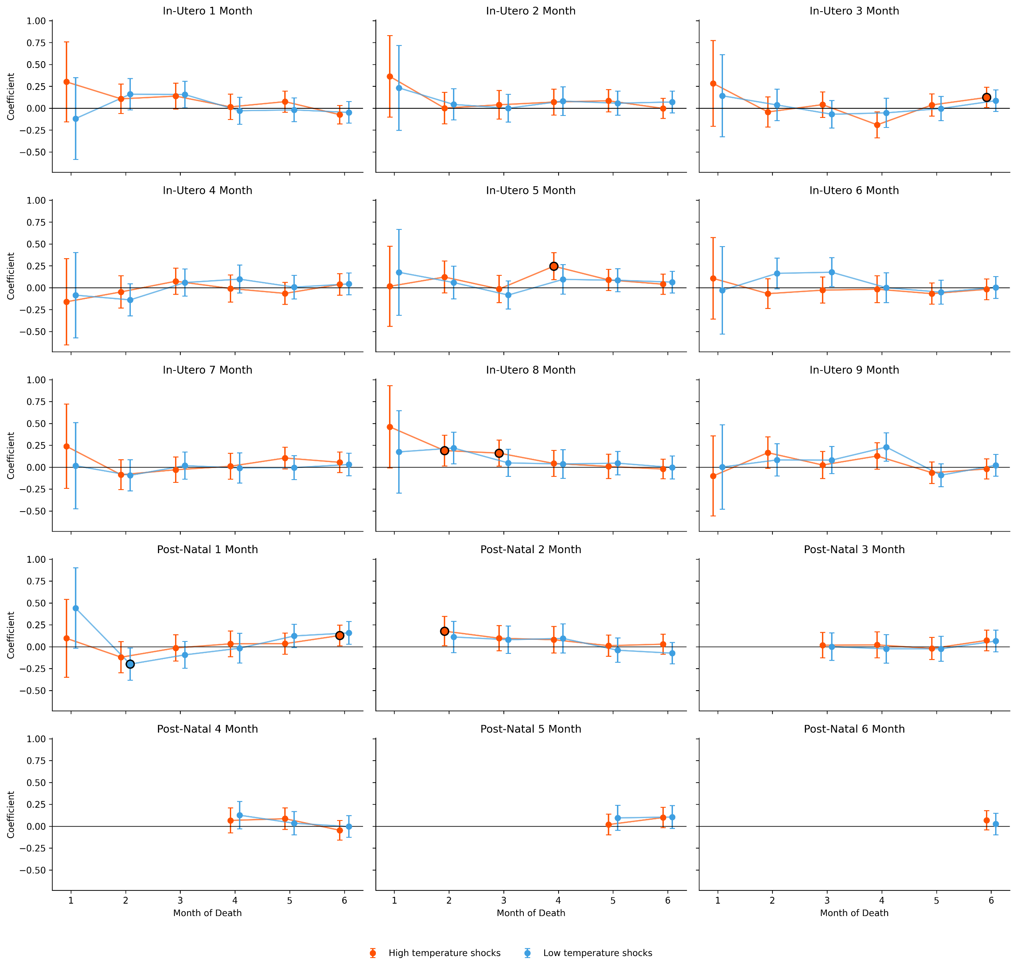
2) Month by month estimates – Temperature
In-utero Q1 high temp shocks here are consistently positive on the first month of life but SE are large…
Nothing consistent here… Similar to our previous charts.
Why are this coefficients 1/3 of the size of the quarterly estimates?
Is it the averaging window?
Same as Q1, on the first year we have large coefficients but also large SE…
Quite a mystery here tho. I suspect that large shocks could increase the likelihood of stillbirth and therefore not shown here... Let me know what you think.

Slide 27
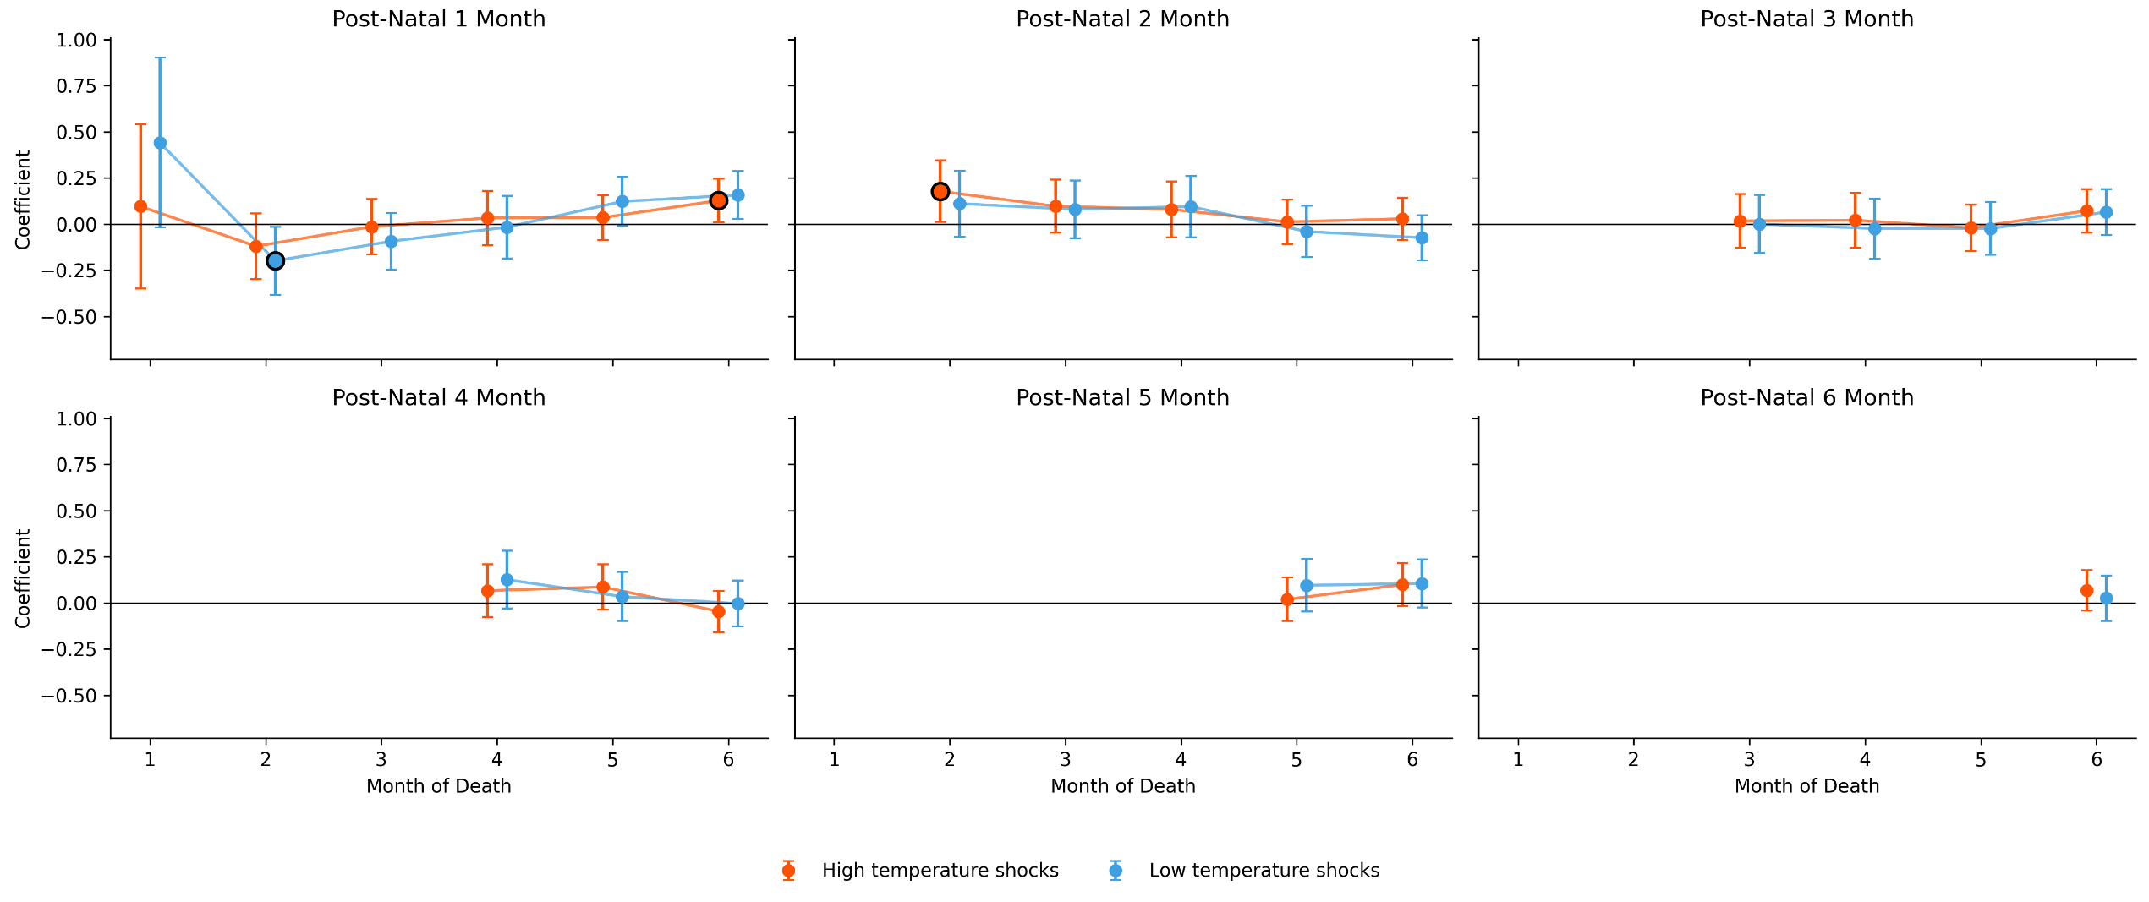
2) Month by month estimates – Temperature
Quite similar as before, consistent positive coefficients but large SE…
Same mystery here… same arguments?

Slide 28
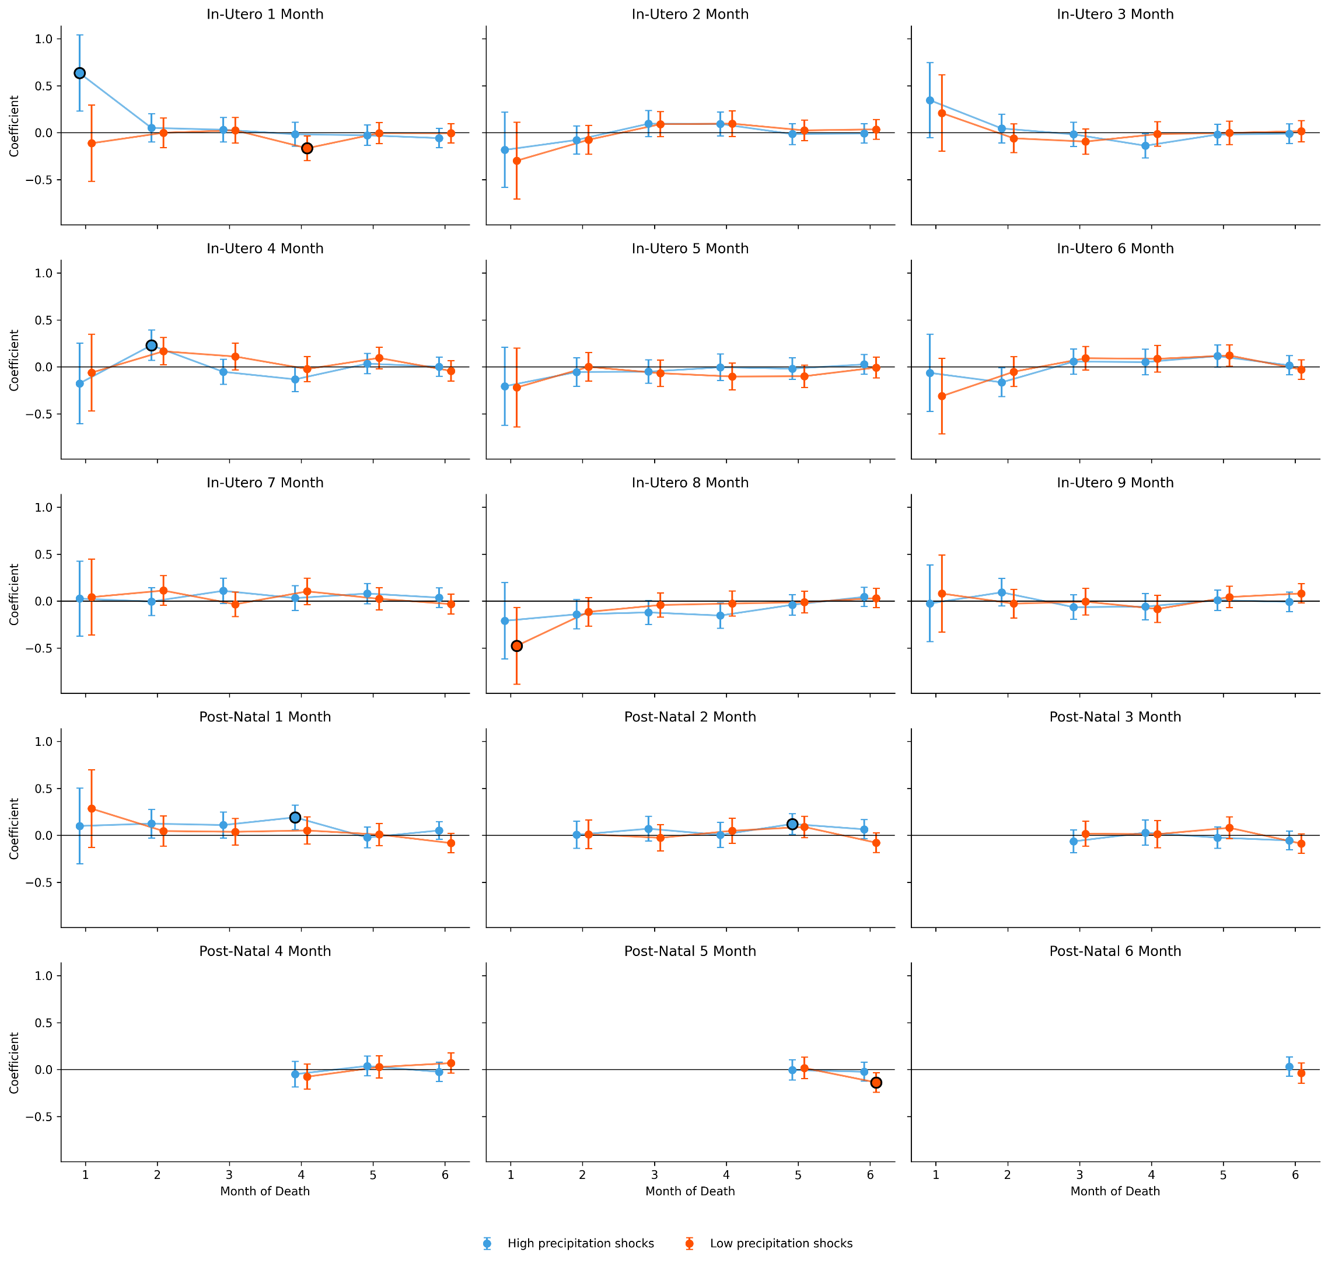
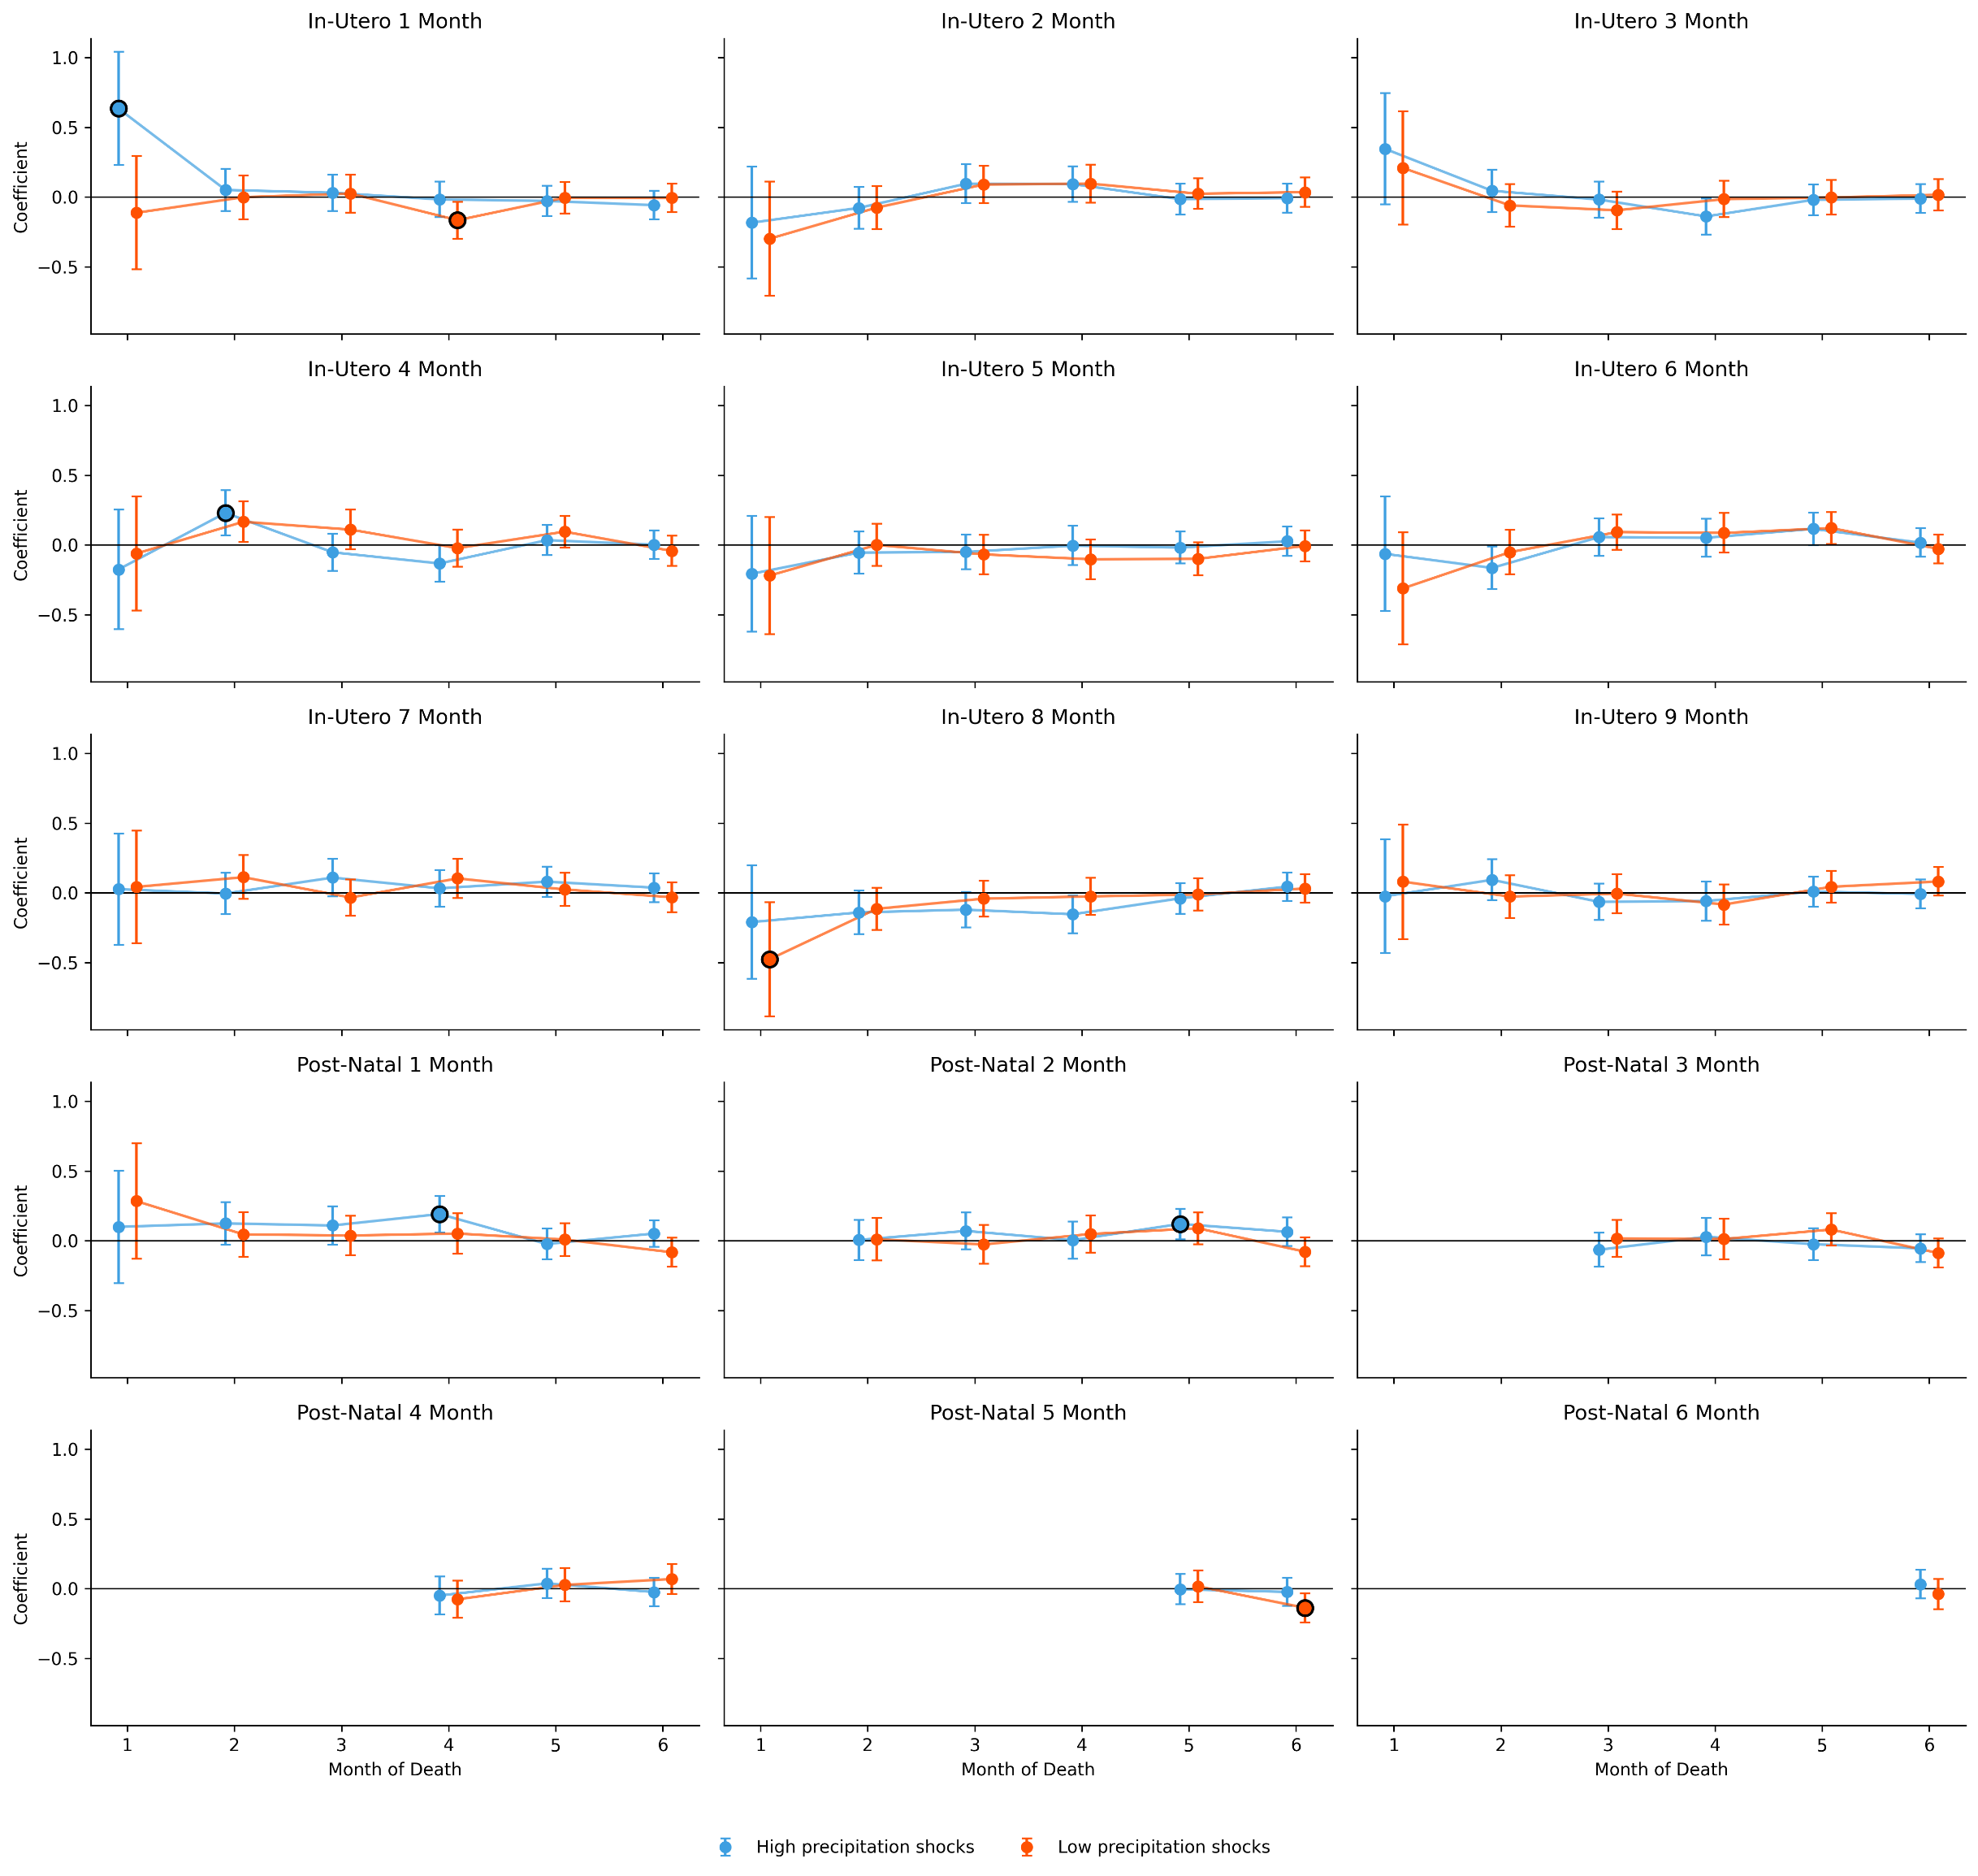
2) Month by month estimates – Precipitation
In SPI I don’t see anything consistent…

Slide 29
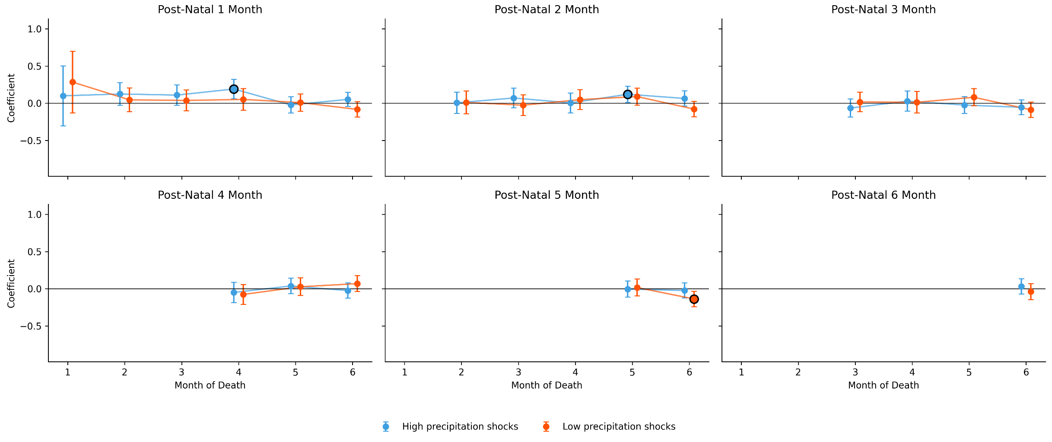
2) Month by month estimates – Precipitation
In SPI I don’t see anything consistent…

Slide 30
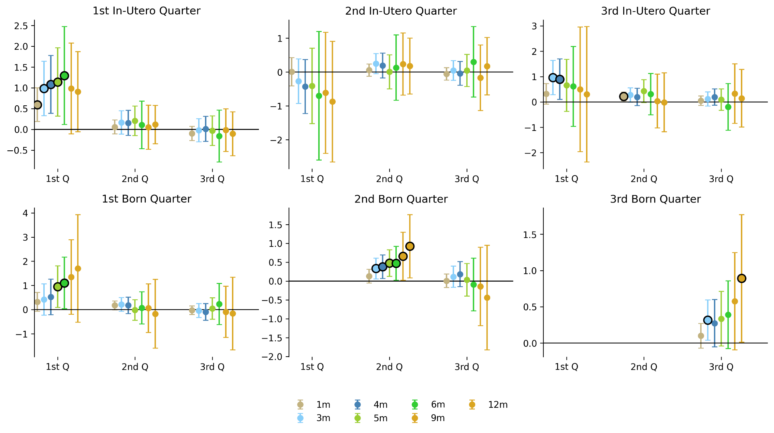
3) Averaging window – High Temperature

Slide 31
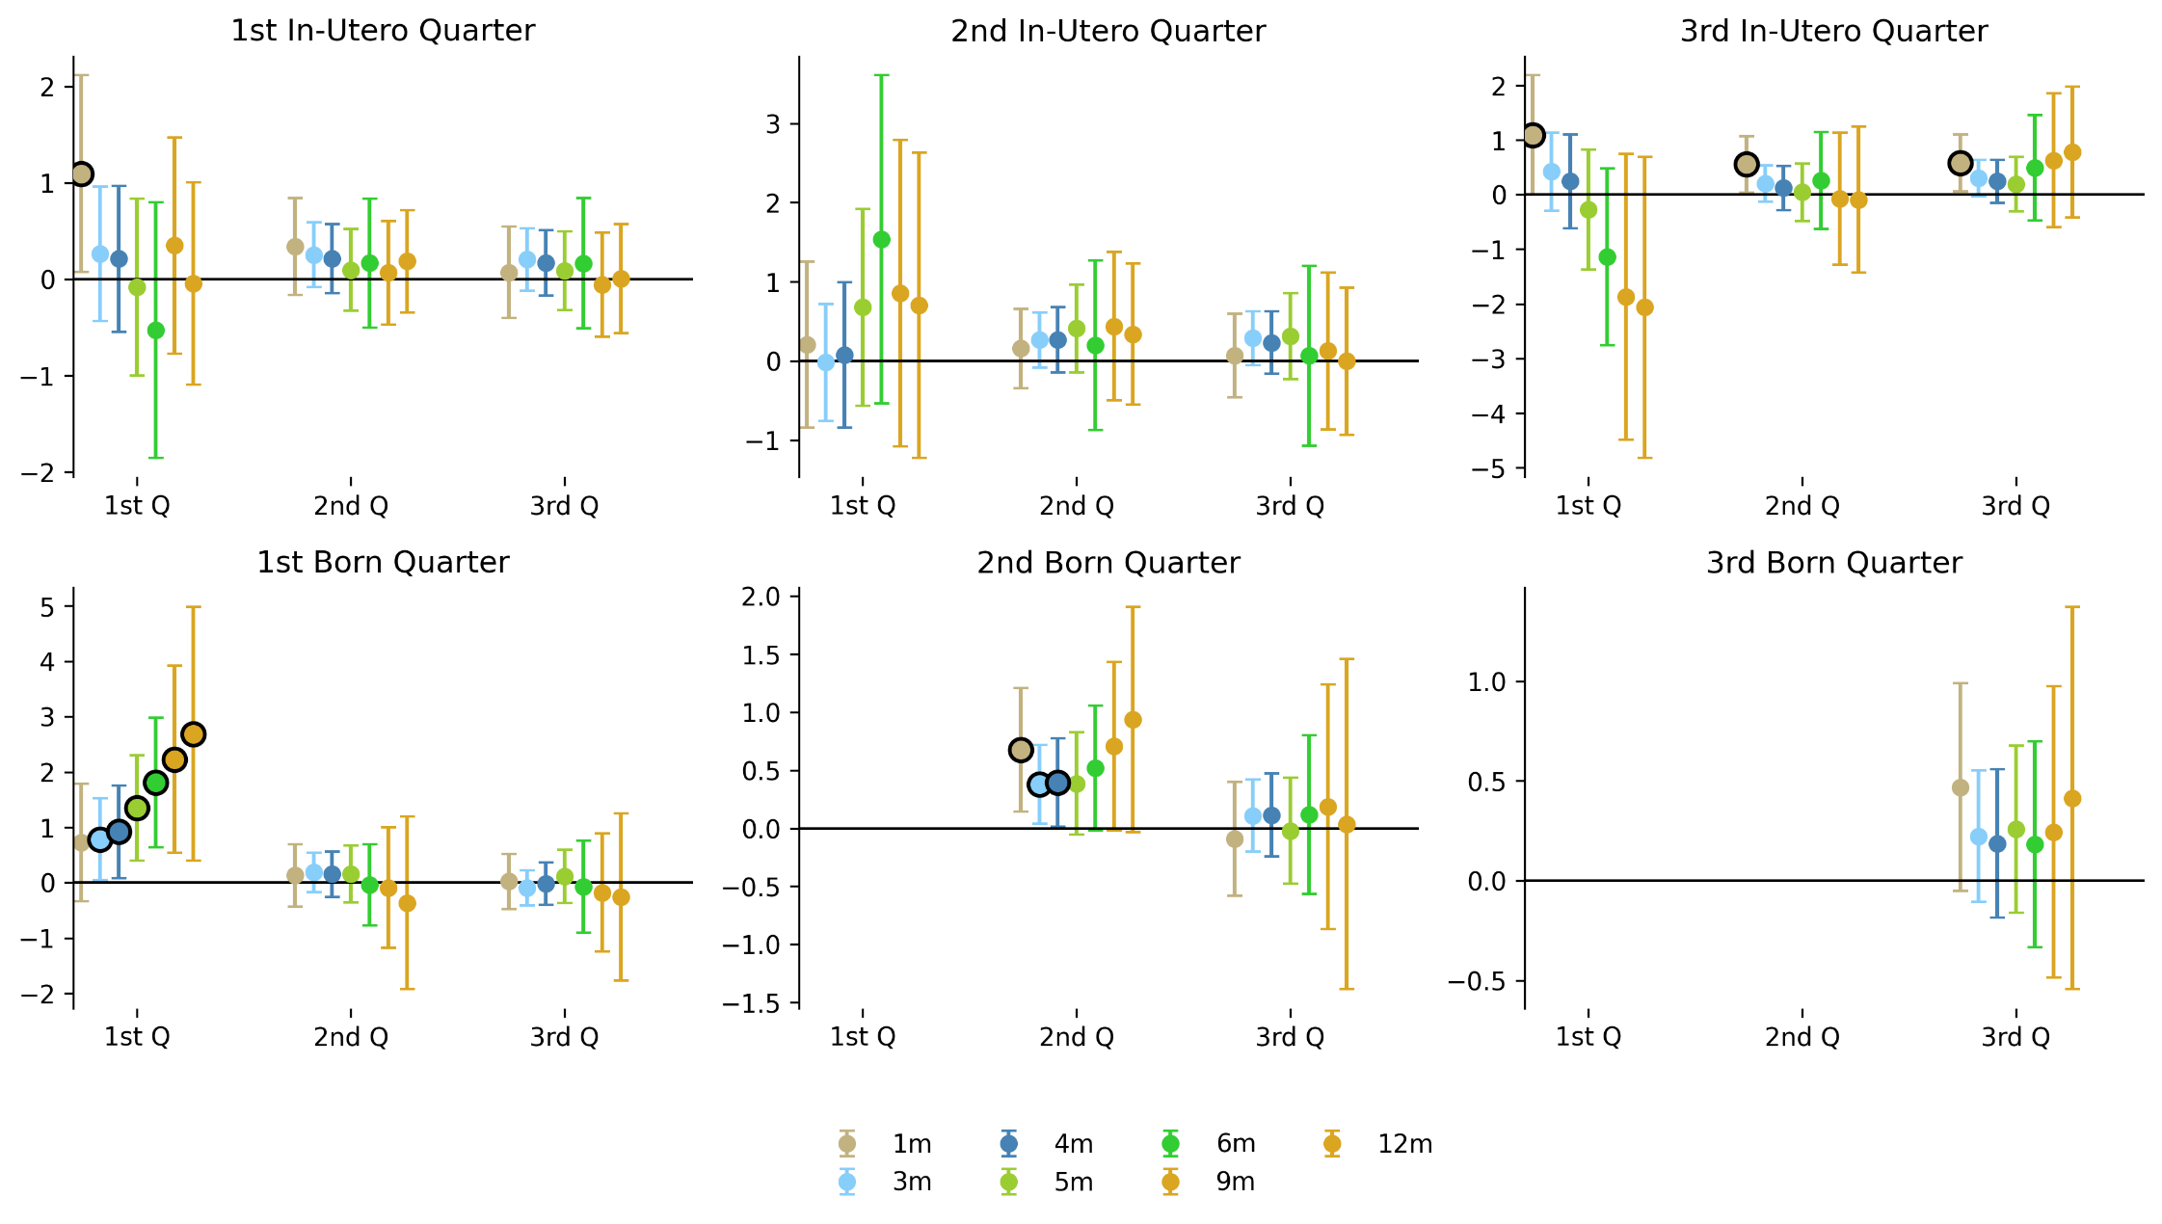
3) Averaging window – Low Temperature

Slide 32
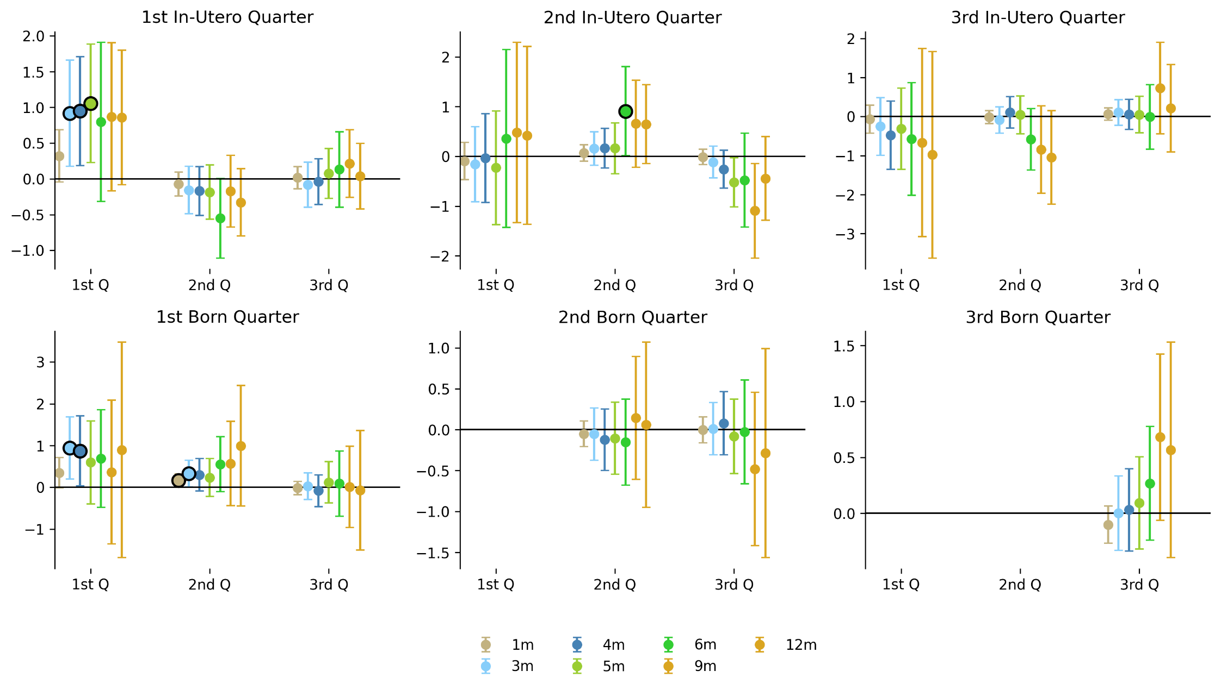
3) Averaging window – High Precipitation

Slide 33
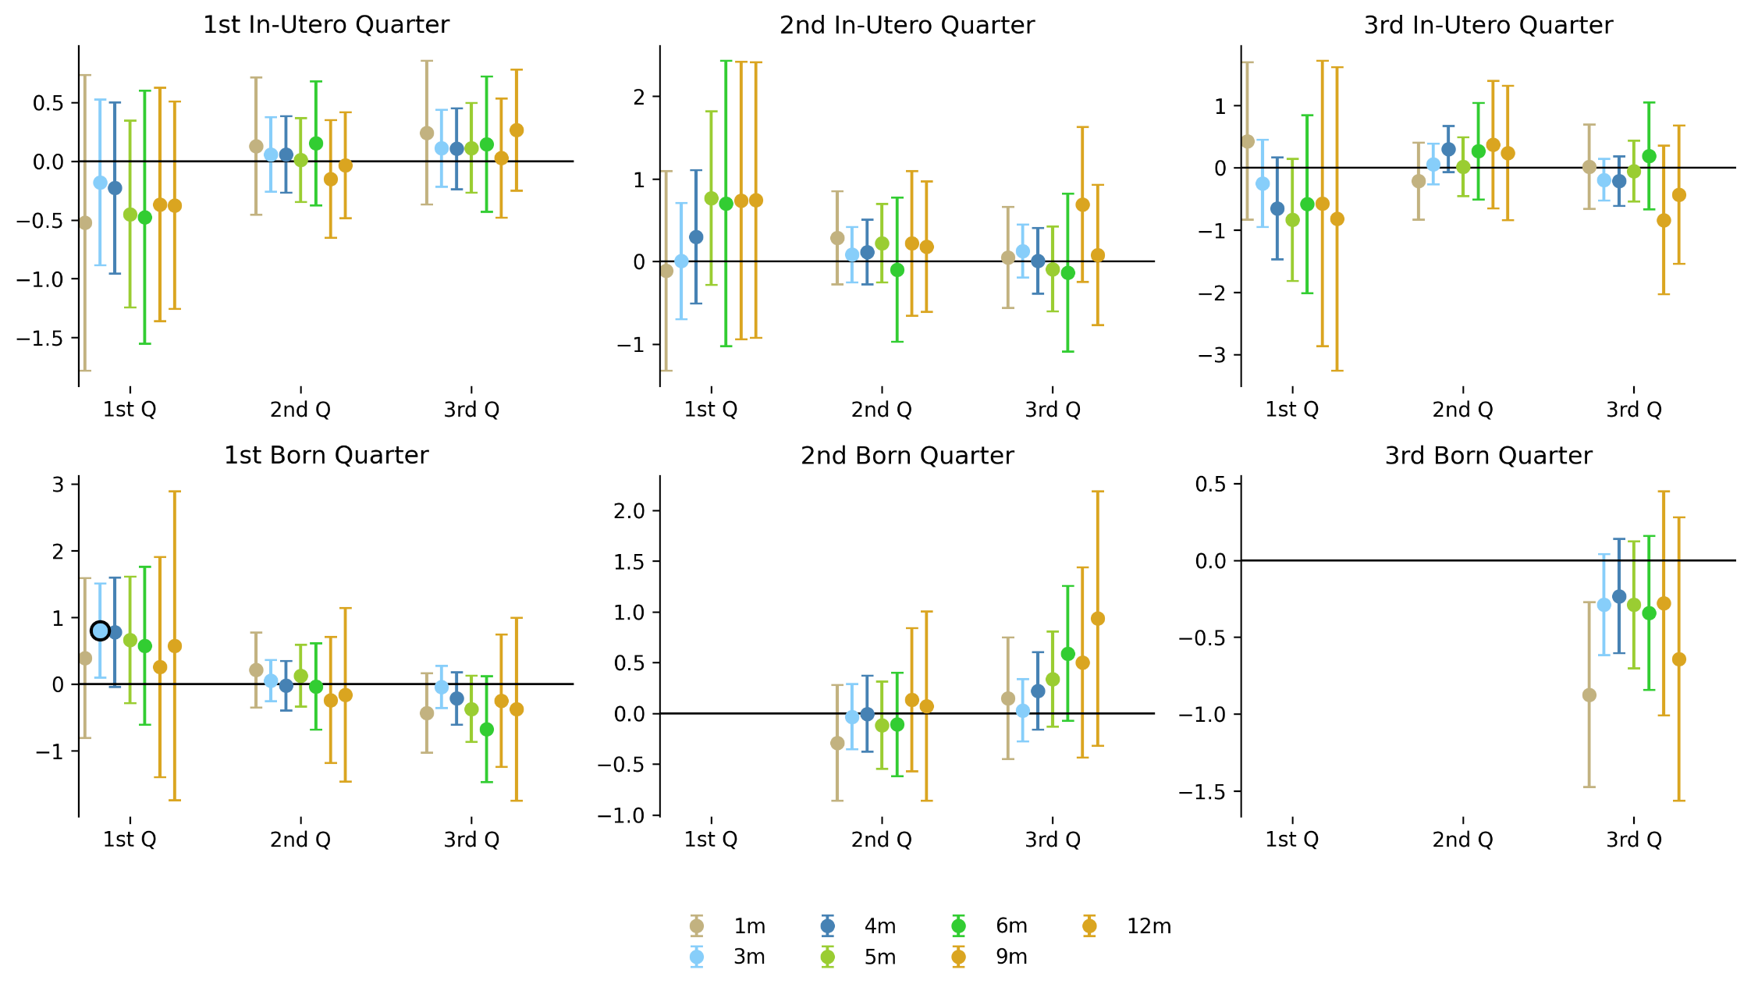
3) Averaging window – Low Precipitation

Slide 34
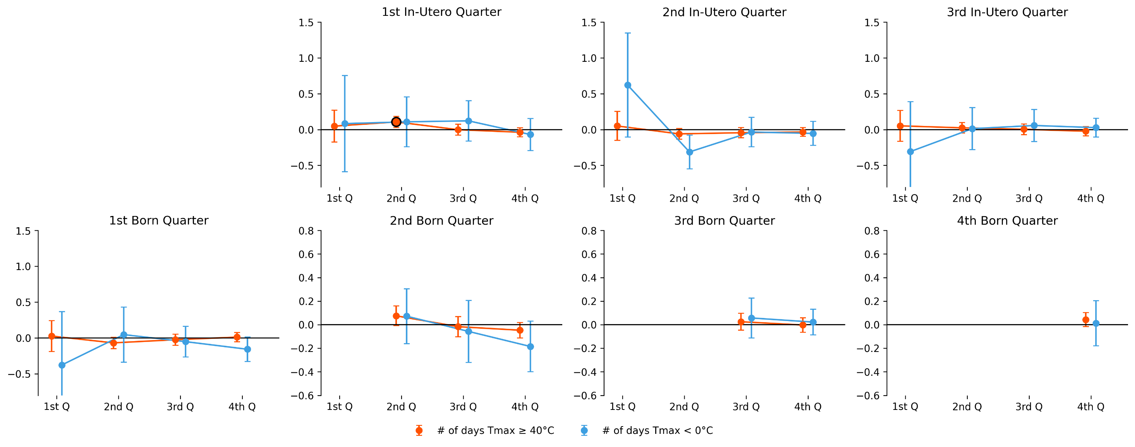
4) N° of cold/heatdays – Temperature
We’ve run regs like this one for
Tmax>35° and 40° as a heat-days variables, and Tmax<0° and Tmin<0° as cold-days.
Tmax<40° and Tmax<0° were the “best ones”

Slide 35
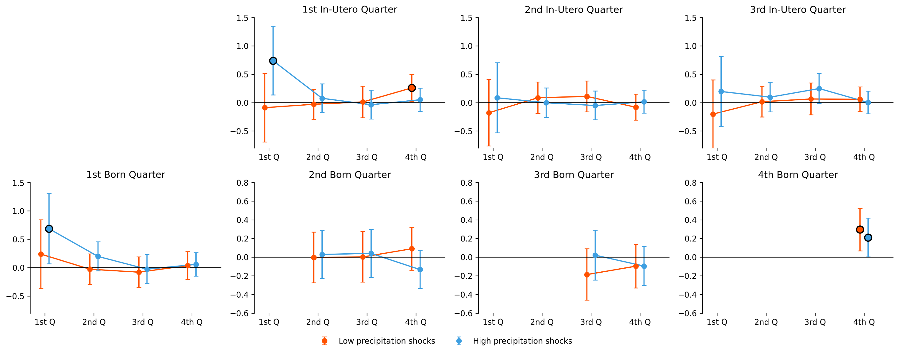
4) N° of cold/heatdays – Precipitation

Slide 36
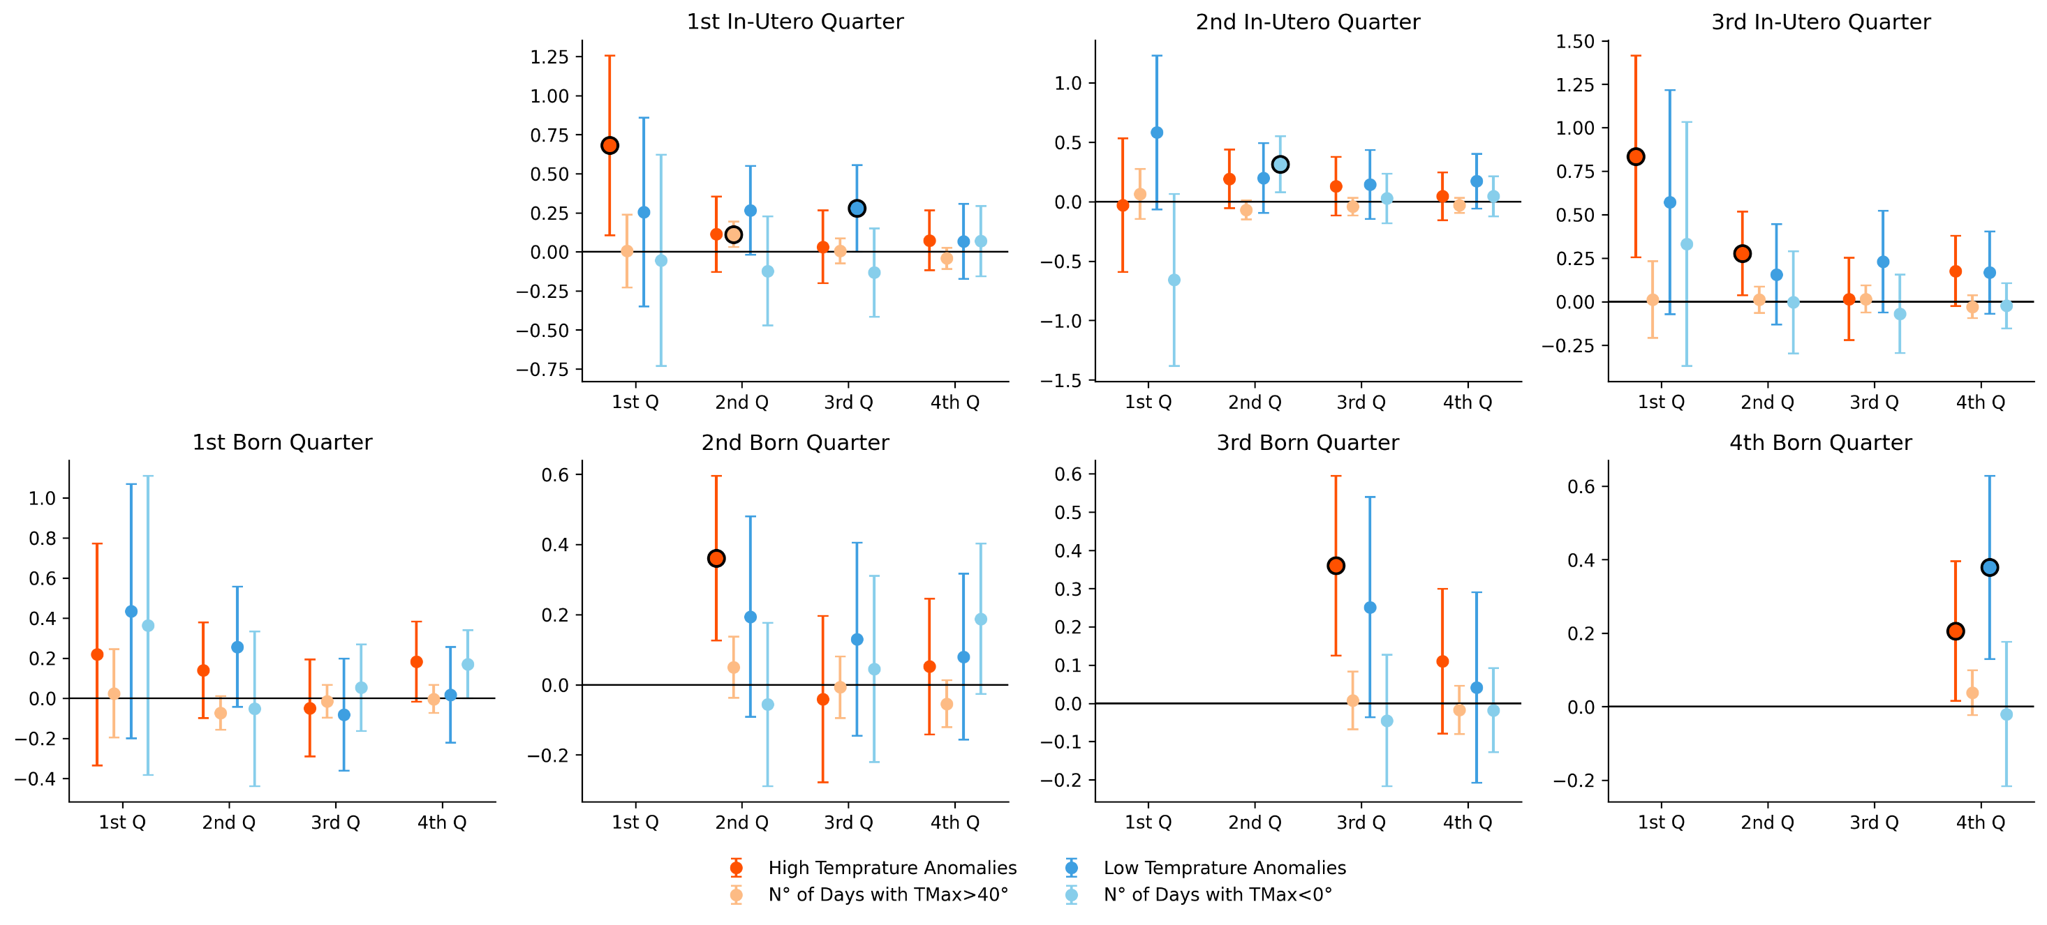
5) “Horserace” (Tmax>40°C & Tmax<0°) - Temperature
The coefficients of standardized monthly temperatura are almost EXACTLY the ones from the main result!

Slide 37
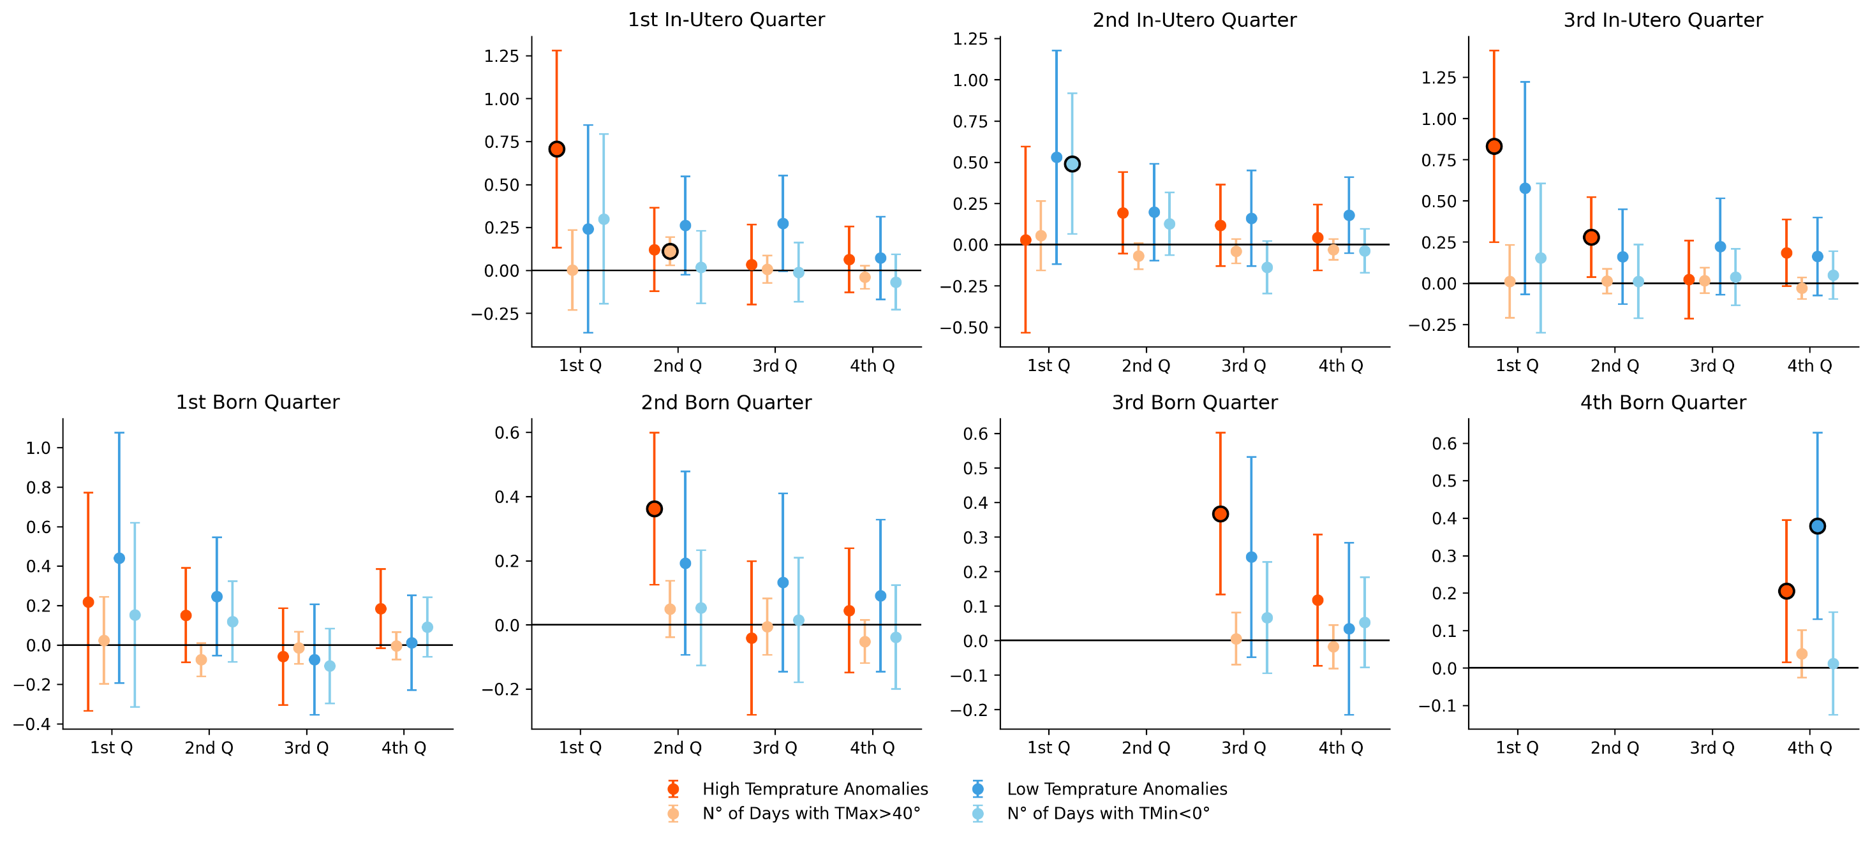
5) “Horserace” (Tmax>40°C & Tmix<0°) - Temperature

Slide 38
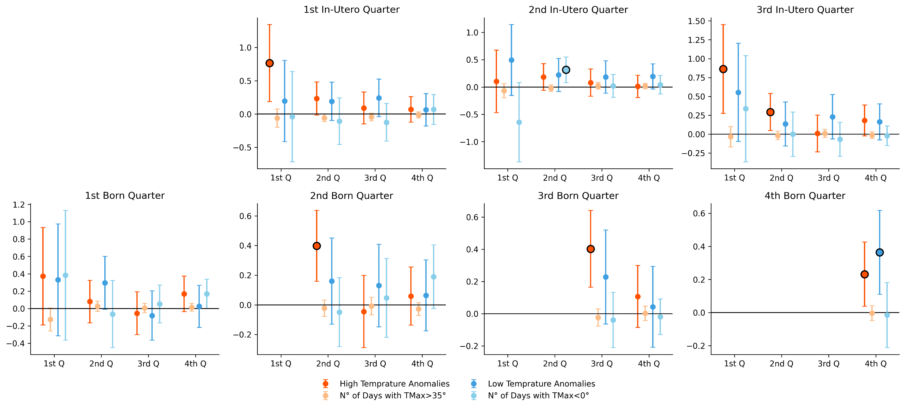
5) “Horserace” (Tmax>35°C & Tmax<0°) - Temperature
The coefficients of standardized monthly temperatura are almost EXACTLY the ones from the main result!

Slide 39
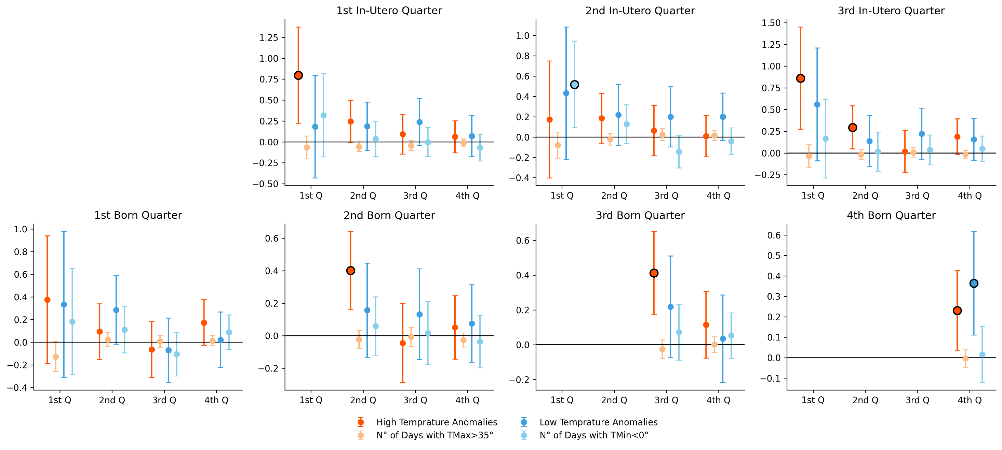
5) “Horserace” (Tmax>35°C & Tmin<0°) - Temperature
The coefficients of standardized monthly temperatura are almost EXACTLY the ones from the main result!

Slide 40
Mechanisms?
Household has Electricity
Household has a Fridge
Household has Piped Water
Household has a Fan

Slide 41
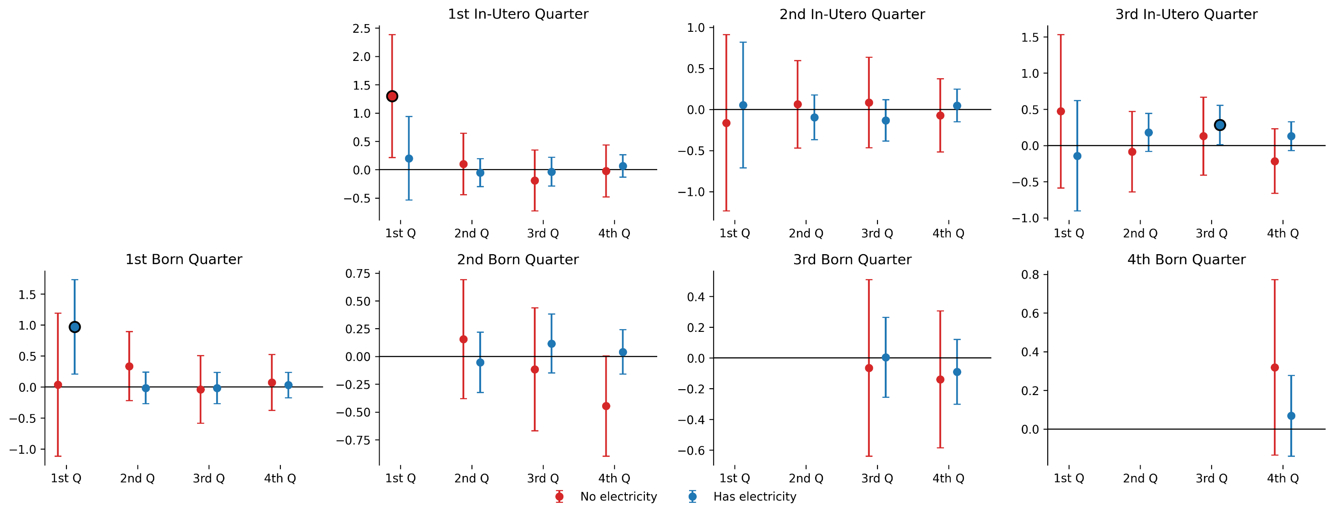
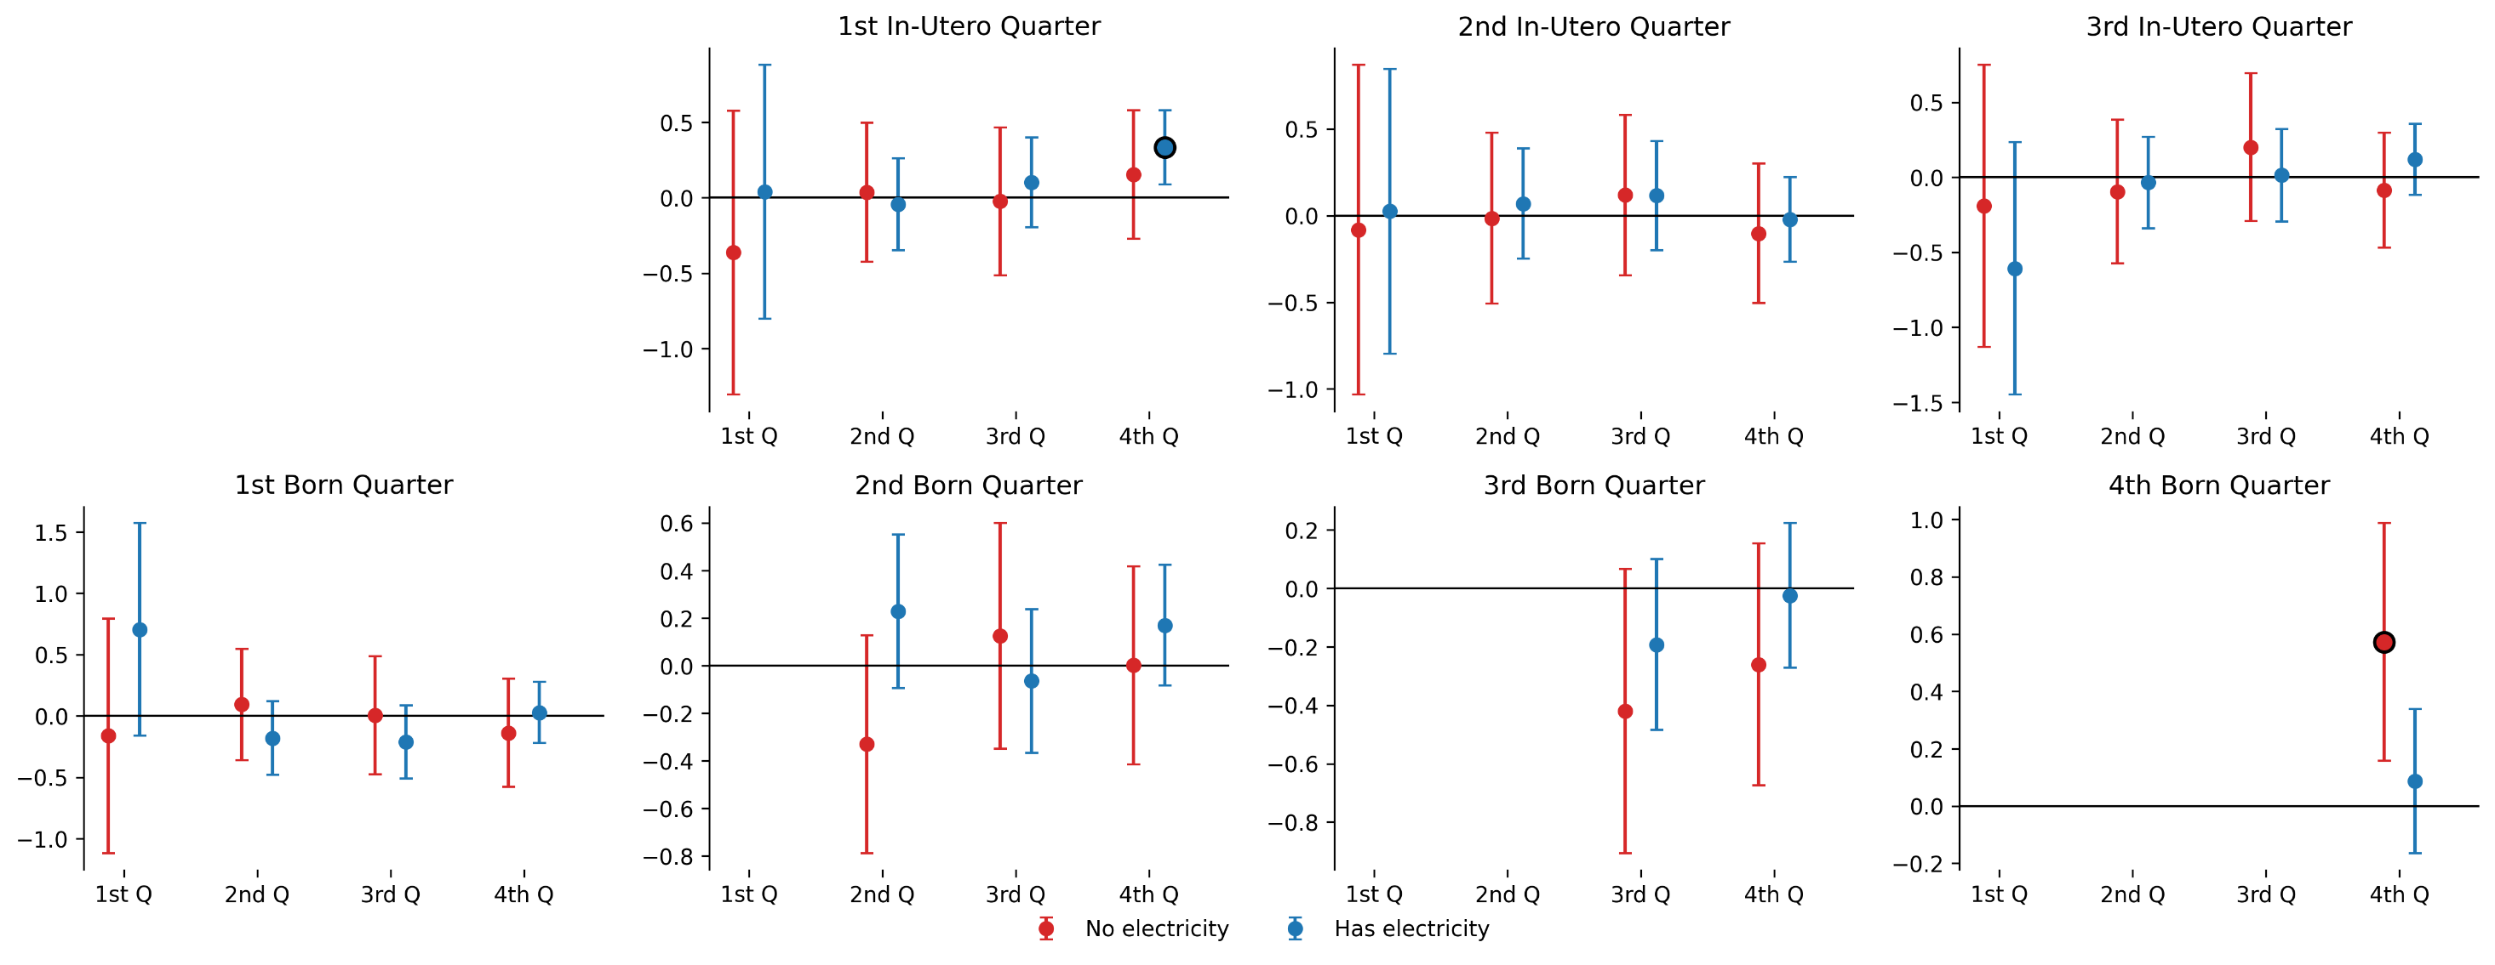
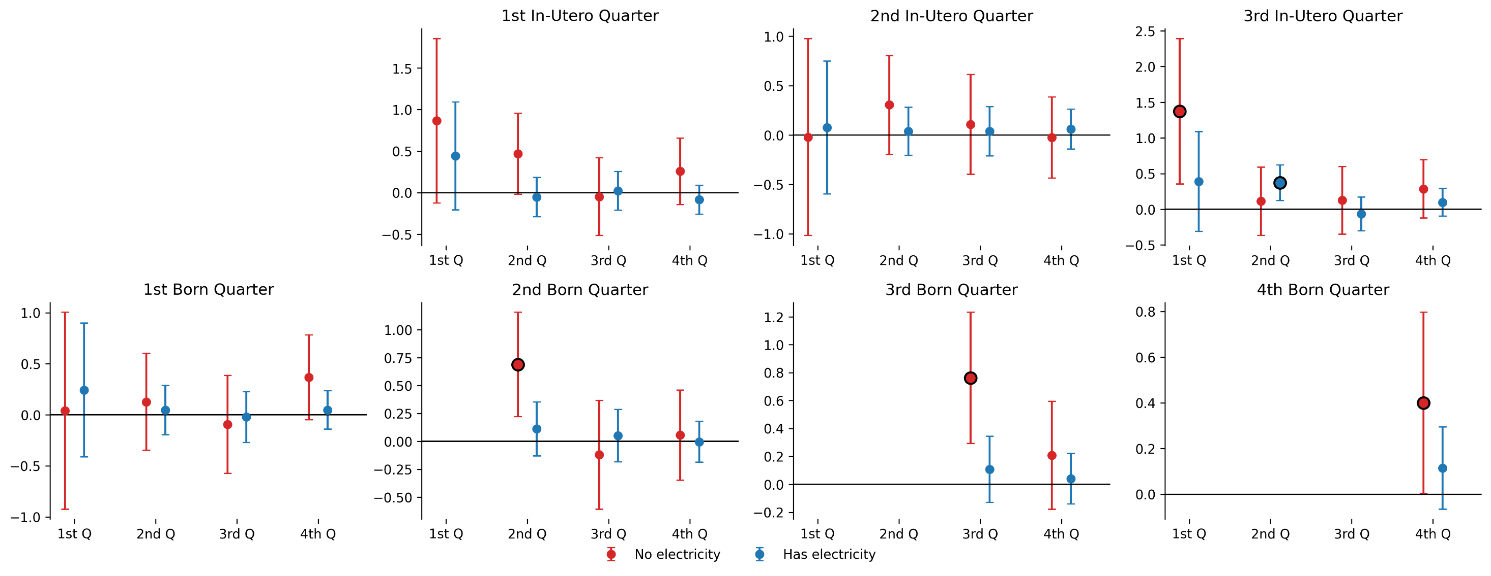
1) Electricity Access – High Temperature Quarters
I believe we might have a story with electricity

Slide 42
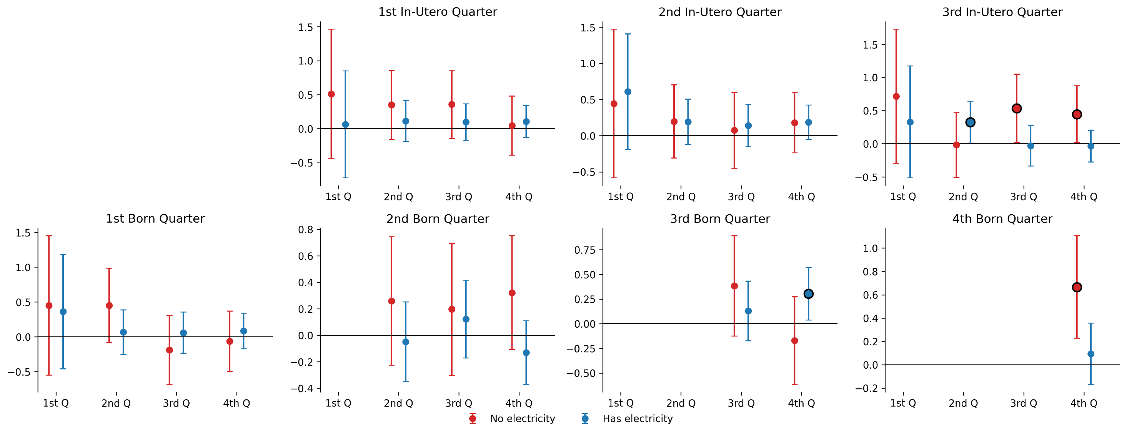
1) Electricity Access – Low Temperature Quarters

Slide 43
1) Electricity Access – High Precipitation Quarters

Slide 44
1) Electricity Access – Low Precipitation Quarters

Slide 45
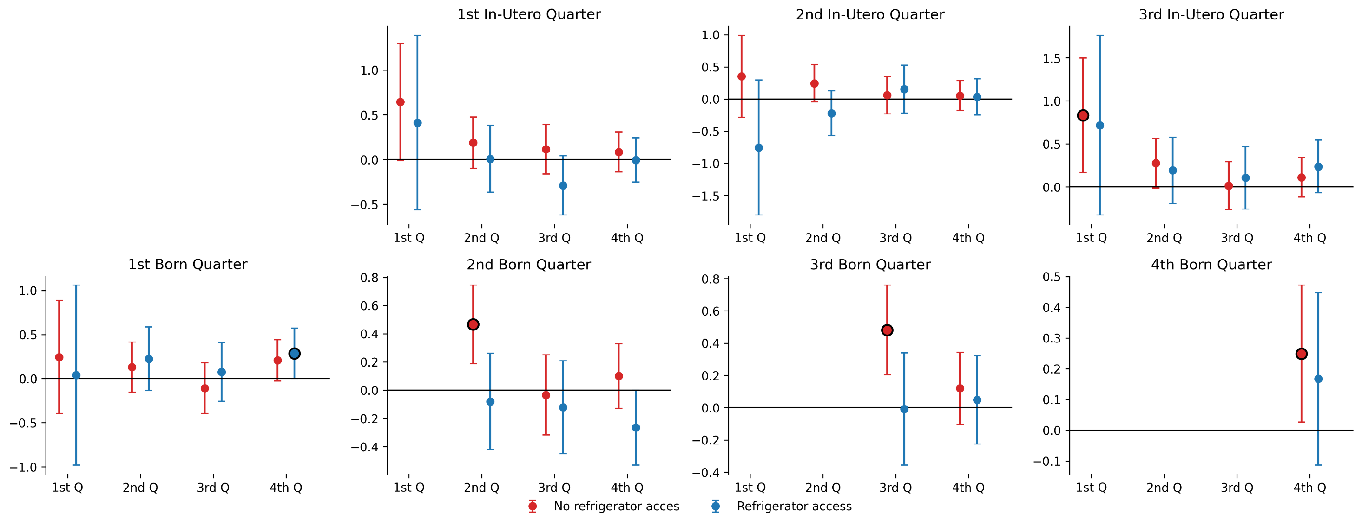
2) Fridge Access – High Temperature Quarters
And, maybe, a story with food-borne diseases?

Slide 46
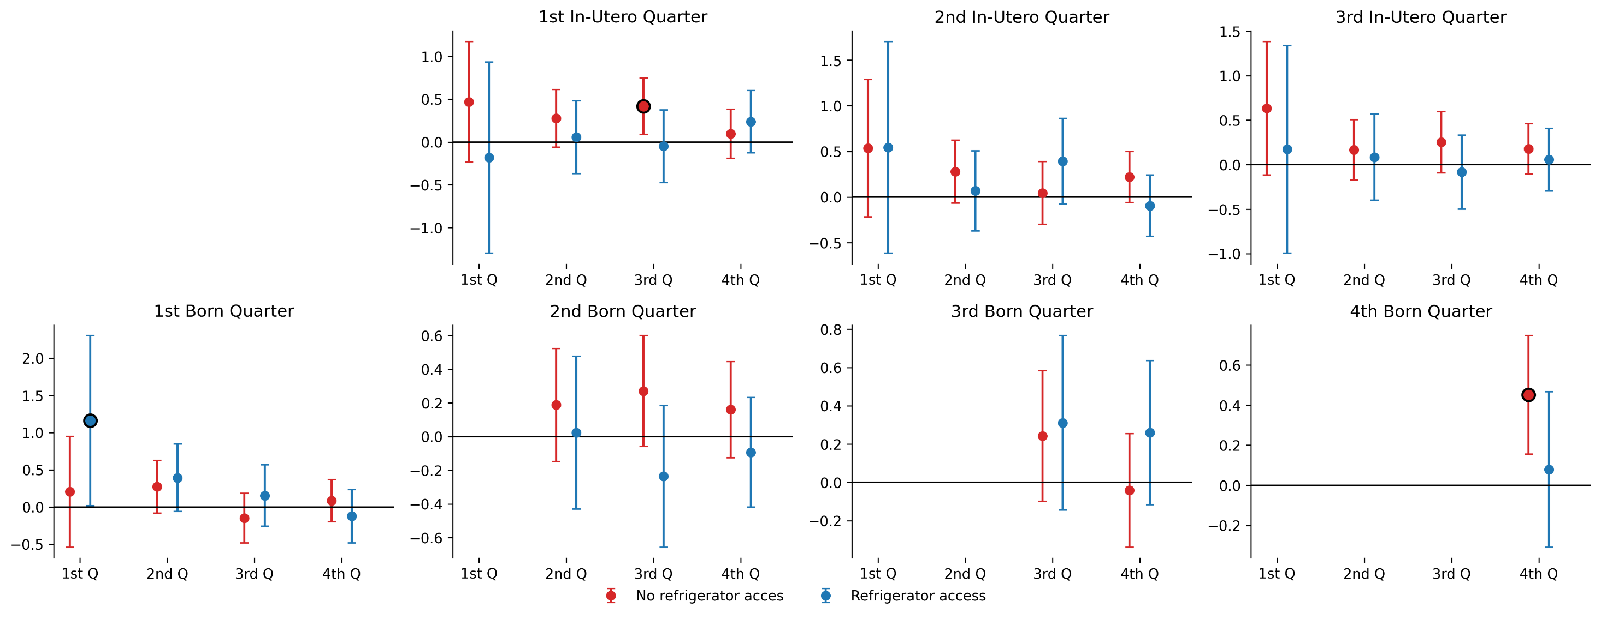
2) Fridge Access – Low Temperature Quarters

Slide 47
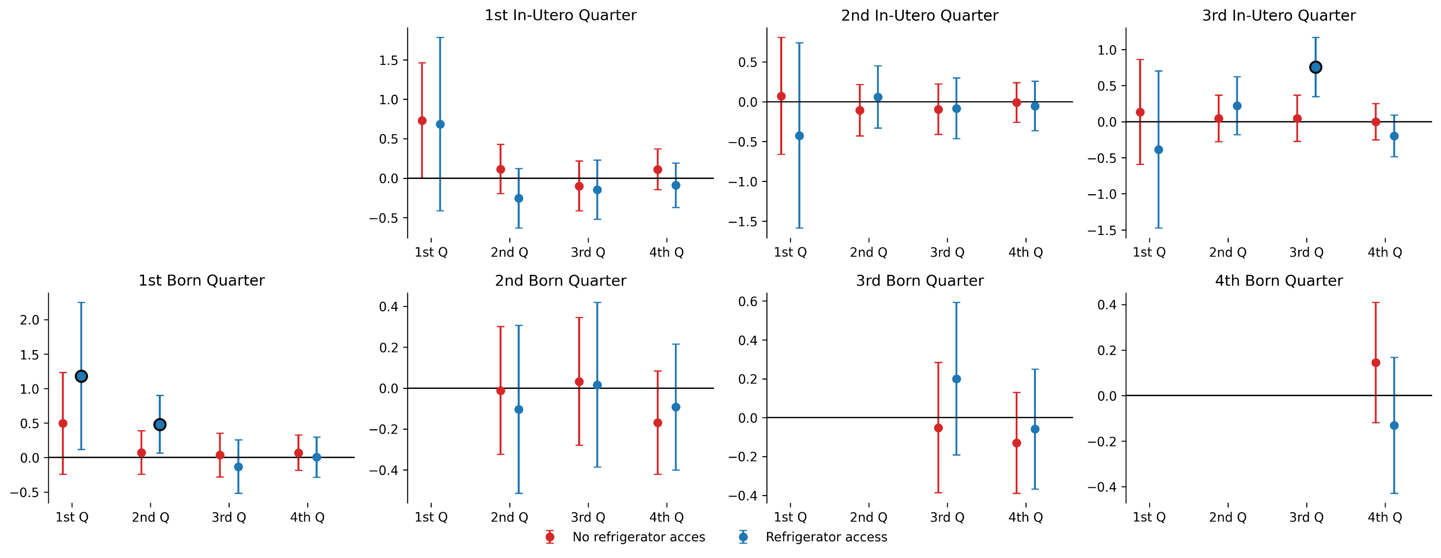
2) Fridge Access – High Precipitation Quarters
This one’s weird tho…

Slide 48
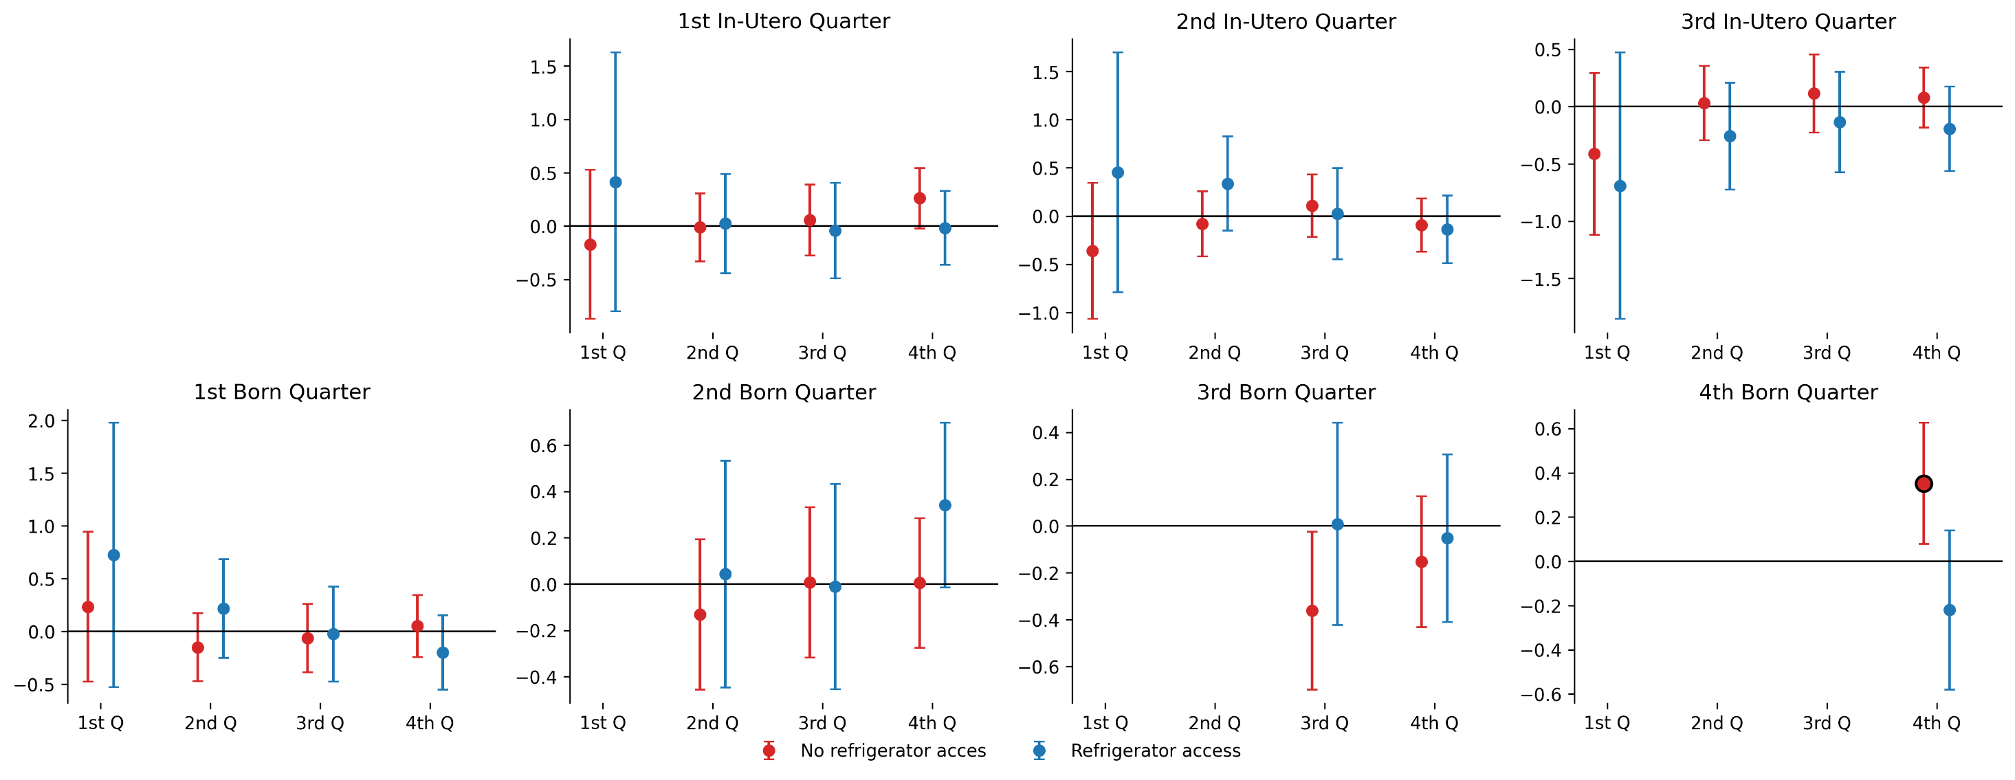
2) Fridge Access – Low Precipitation Quarters

Slide 49
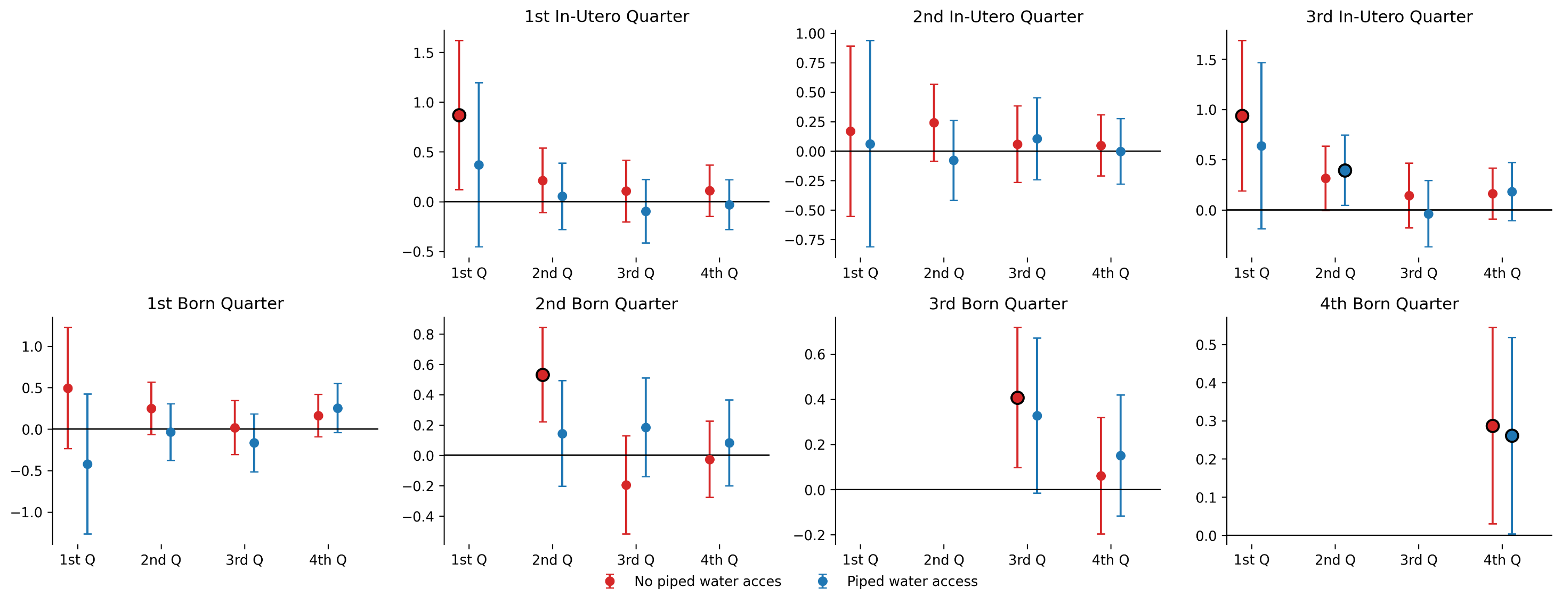
3) Piped Water Access – High Temperature Quarters
I don’t think there’s anything here but wanted you to check it out

Slide 50
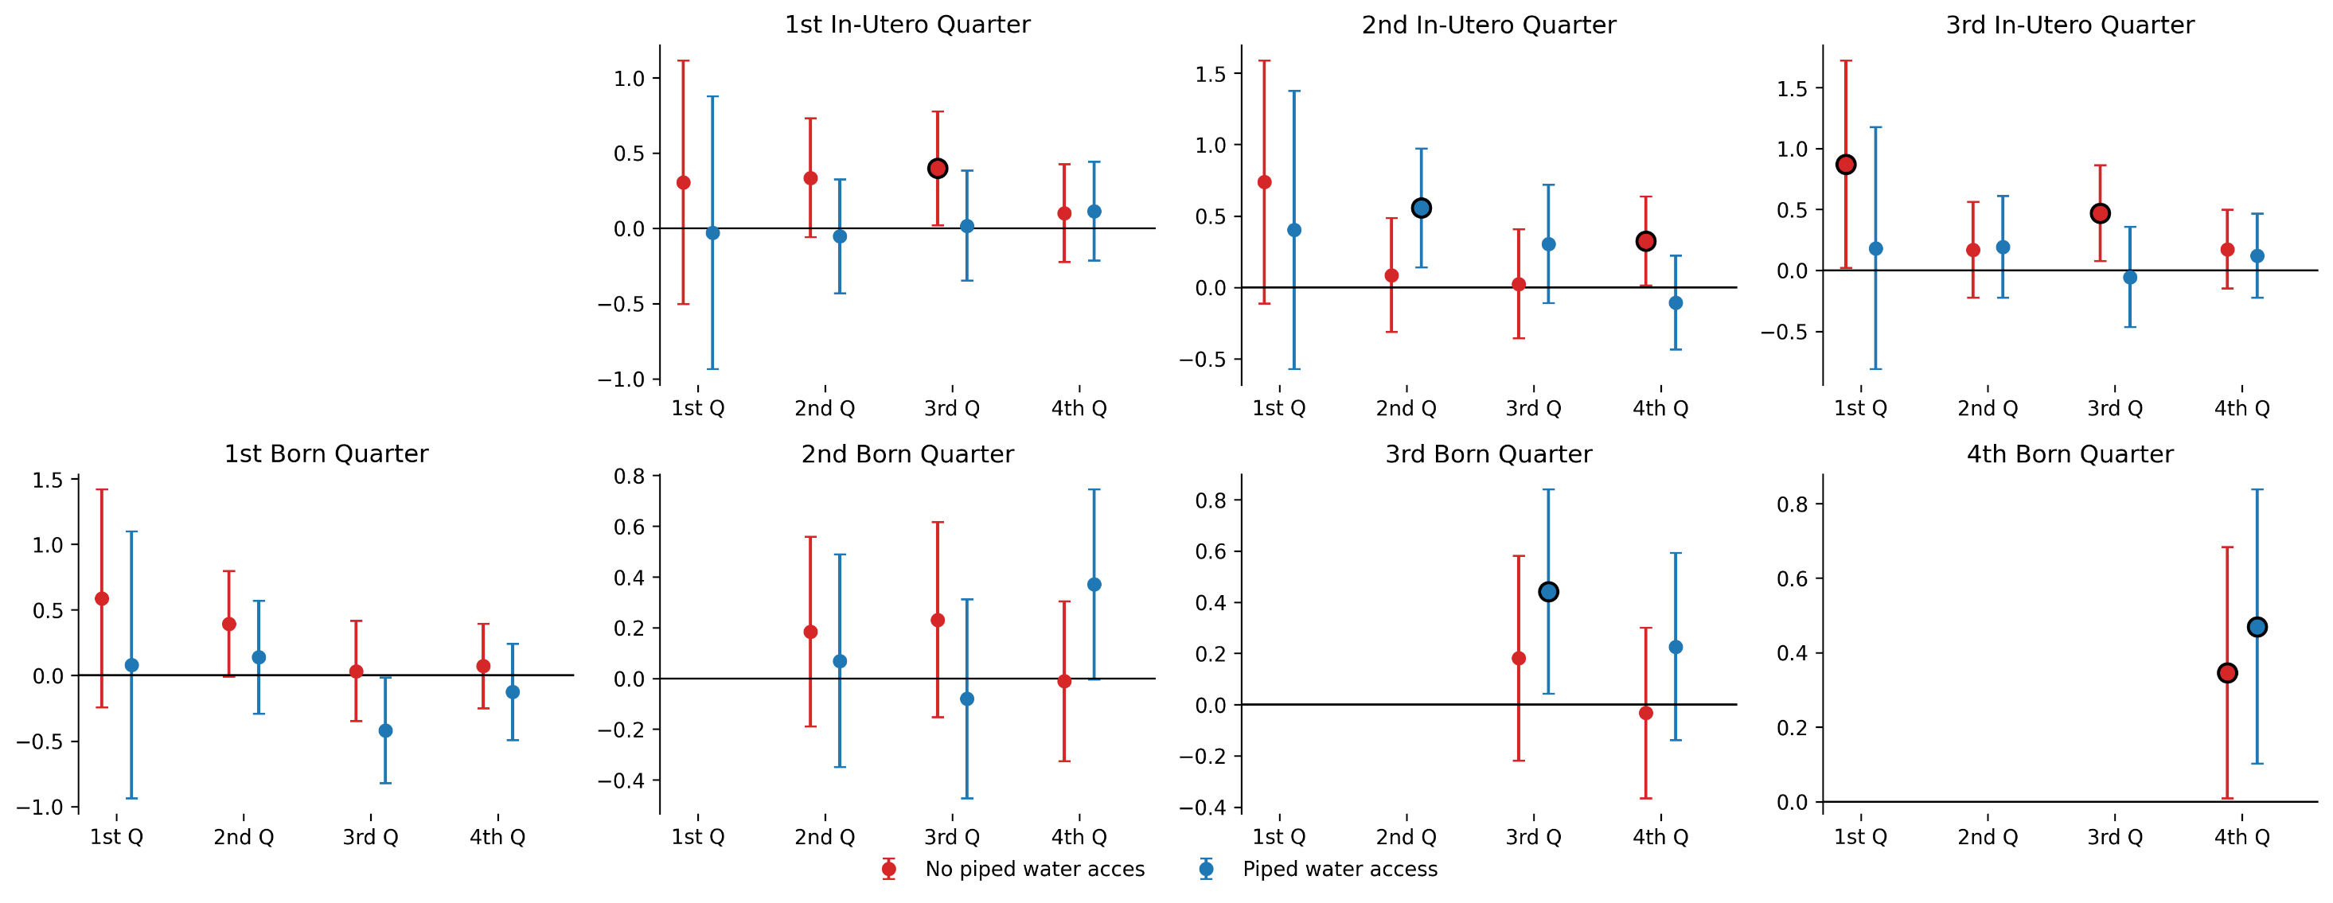
3) Piped Water Access – Low Temperature Quarters

Slide 51
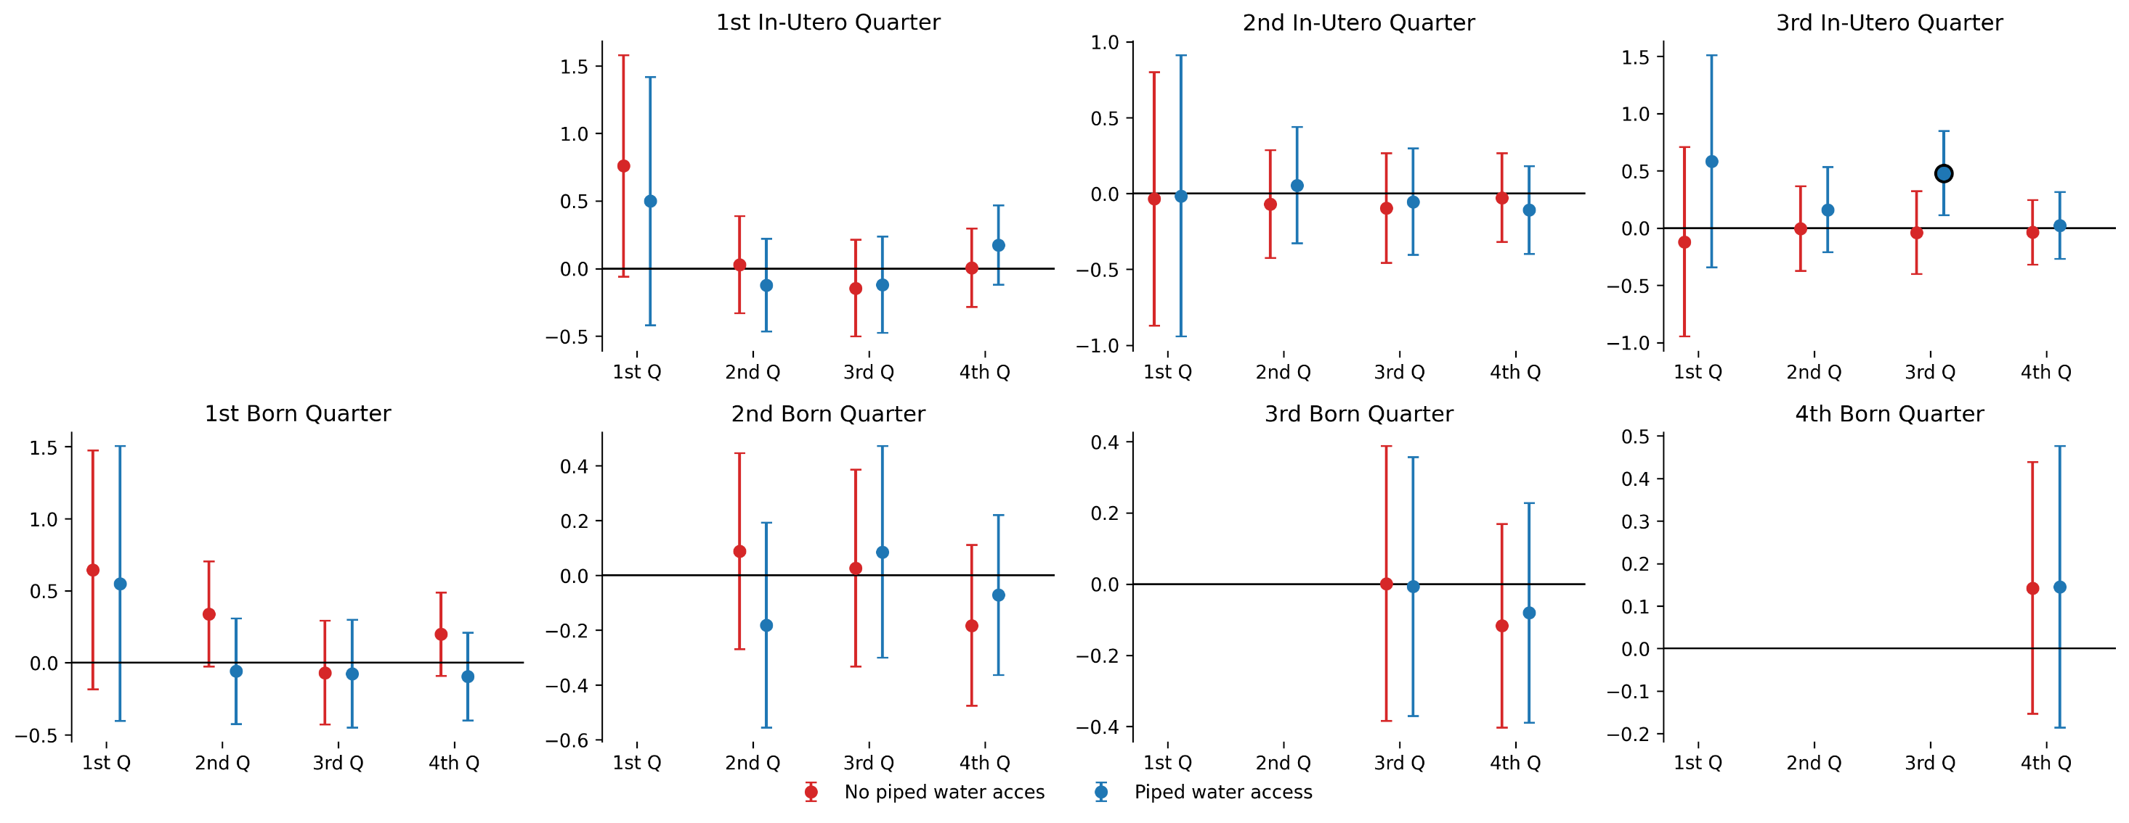
3) Piped Water Access – High Precipitation Quarters

Slide 52
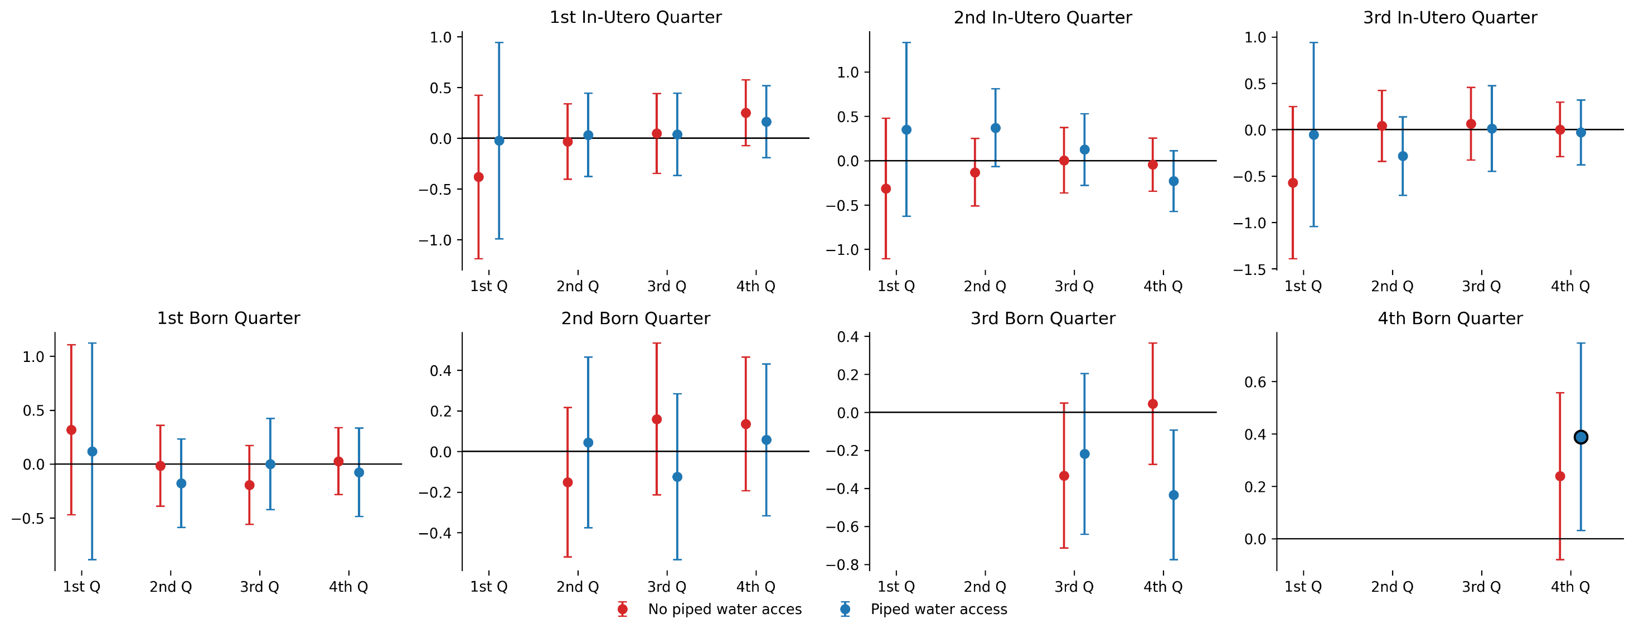
3) Piped Water Access – Low Precipitation Quarters

Slide 53
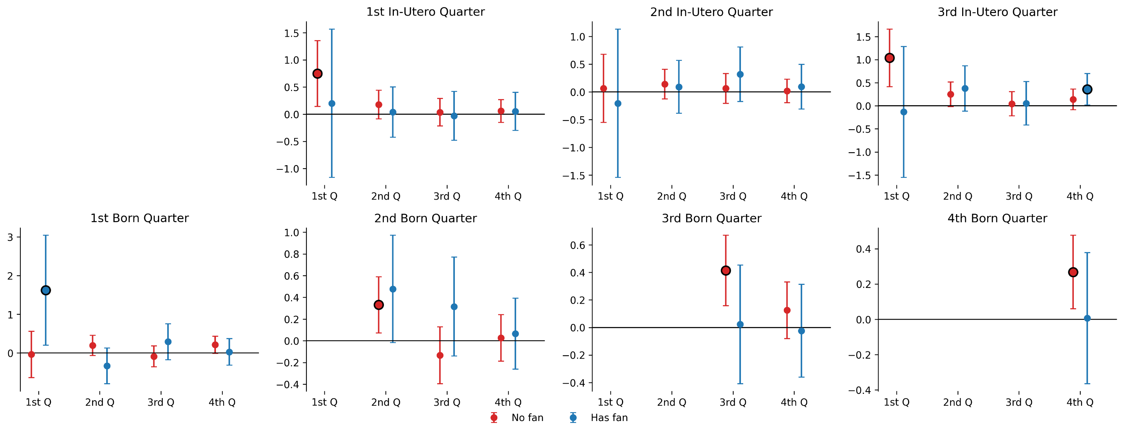
4) Fan Access – High Temperature Quarters
Same here

Slide 54

4) Fan Access – Low Temperature Quarters

Slide 55

4) Fan Access – High Precipitation Quarters

Slide 56

4) Fan Access – Low Precipitation Quarters

Slide 57

5) Mother Education – High Temperature Quarters

Slide 58

5) Mother Education – Low Temperature Quarters

Slide 59

5) Mother Education – High Precipitation Quarters

Slide 60

5) Mother Education – Low Precipitation Quarters

Slide 61
Heterogeneities
Climate bands
“Horserace” by climate bands
Wealth tertiles
DHS quintiles

Slide 62

1) Climate Bands – High Temperature Quarters

Slide 63

1) Climate Bands – Low Temperature Quarters

Slide 64

1) Climate Bands – High Precipitation Quarters

Slide 65

1) Climate Bands – Low Precipitation Quarters

Slide 66

2) Climate Bands Horserace – Temperature
Tropical

Slide 67

2) Climate Bands Horserace – Temperature
Temperate

Slide 68

2) Climate Bands Horserace – Temperature
Arid

Slide 69

3) RWI Tertiles – High Temperature Quarters
Just to remember, RWI is also a control… Maybe this could be an issue?

Slide 70

3) RWI Tertiles – Low Temperature Quarters

Slide 71

3) RWI Tertiles – High Precipitation Quarters

Slide 72

3) RWI Tertiles – Low Precipitation Quarters

Slide 73

4) DHS Quintiles – High Temperature Quarters

Slide 74

4) DHS Quintiles – Low Temperature Quarters

Slide 75

4) DHS Quintiles – High Precipitation Quarters

Slide 76

4) DHS Quintiles – Low Precipitation Quarters

Slide 77
What’s next?

Slide 78
What’s next
I have about a week and a half before moving to NY, so I'd like to get this as polished as possible. I think if we focus on crafting a clear narrative, we can have a draft ready within the next few days.
What do you consider the most important results?
Which figures should we include in the paper?
We should also add the "simulations" figure showing the expected number of child deaths due to climate change, but I'll prepare this once we have our "final“ set of coefficients.
IDEA: instead of trying to see month-by-month (where it looks like we don’t have enough power), instead create 9-months climate groups and see effects in the first 3 years of life?

Slide 79
Thank you!

